Slide 1
Do you recommend this book?
בס"ד
By Gal Halili

Slide 2
בס"ד
Is it possible to predict a book's rating from Storytel website?

Slide 3
Crawling
בס"ד

Slide 4
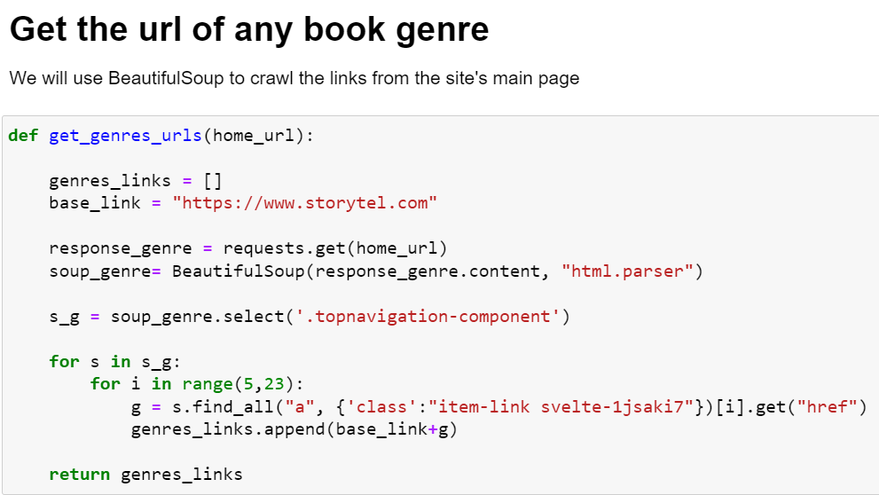
בס"ד

Slide 5
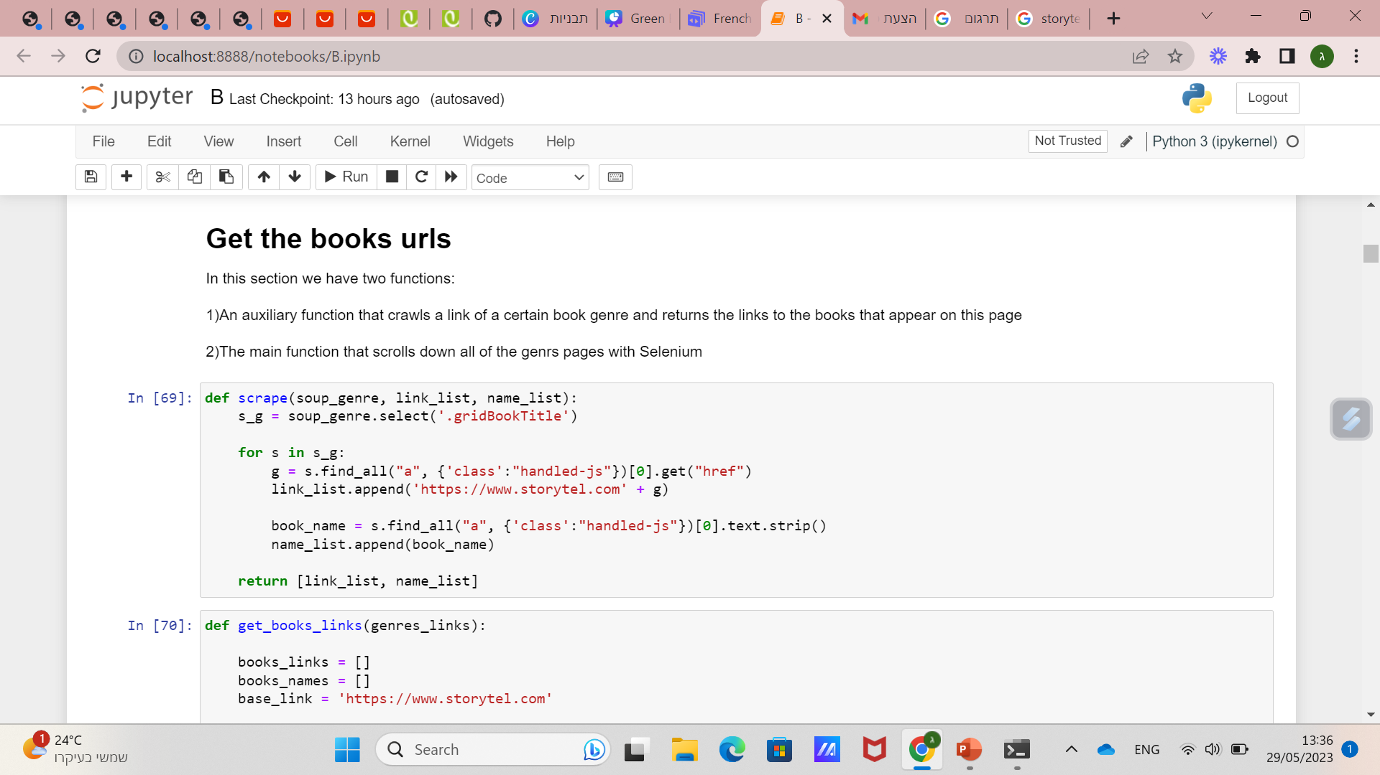
בס"ד

Slide 6
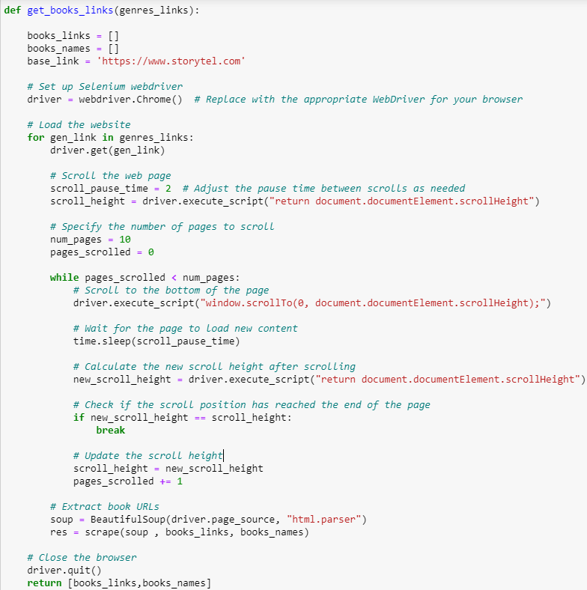
בס"ד
Scroll to the bottom of the page with Selenium and take the links to the book pages

Slide 7
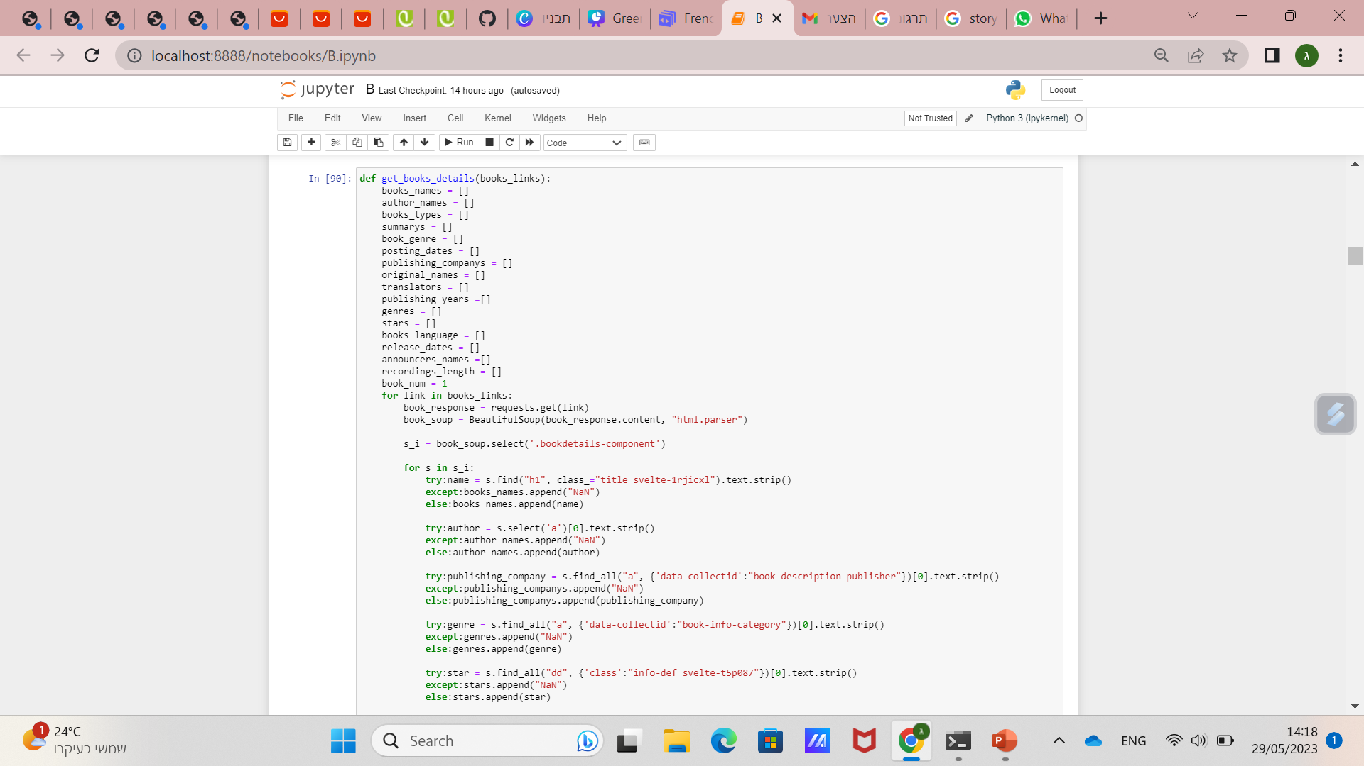
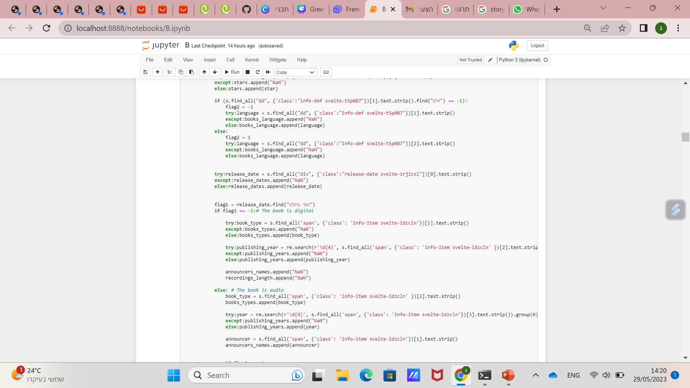
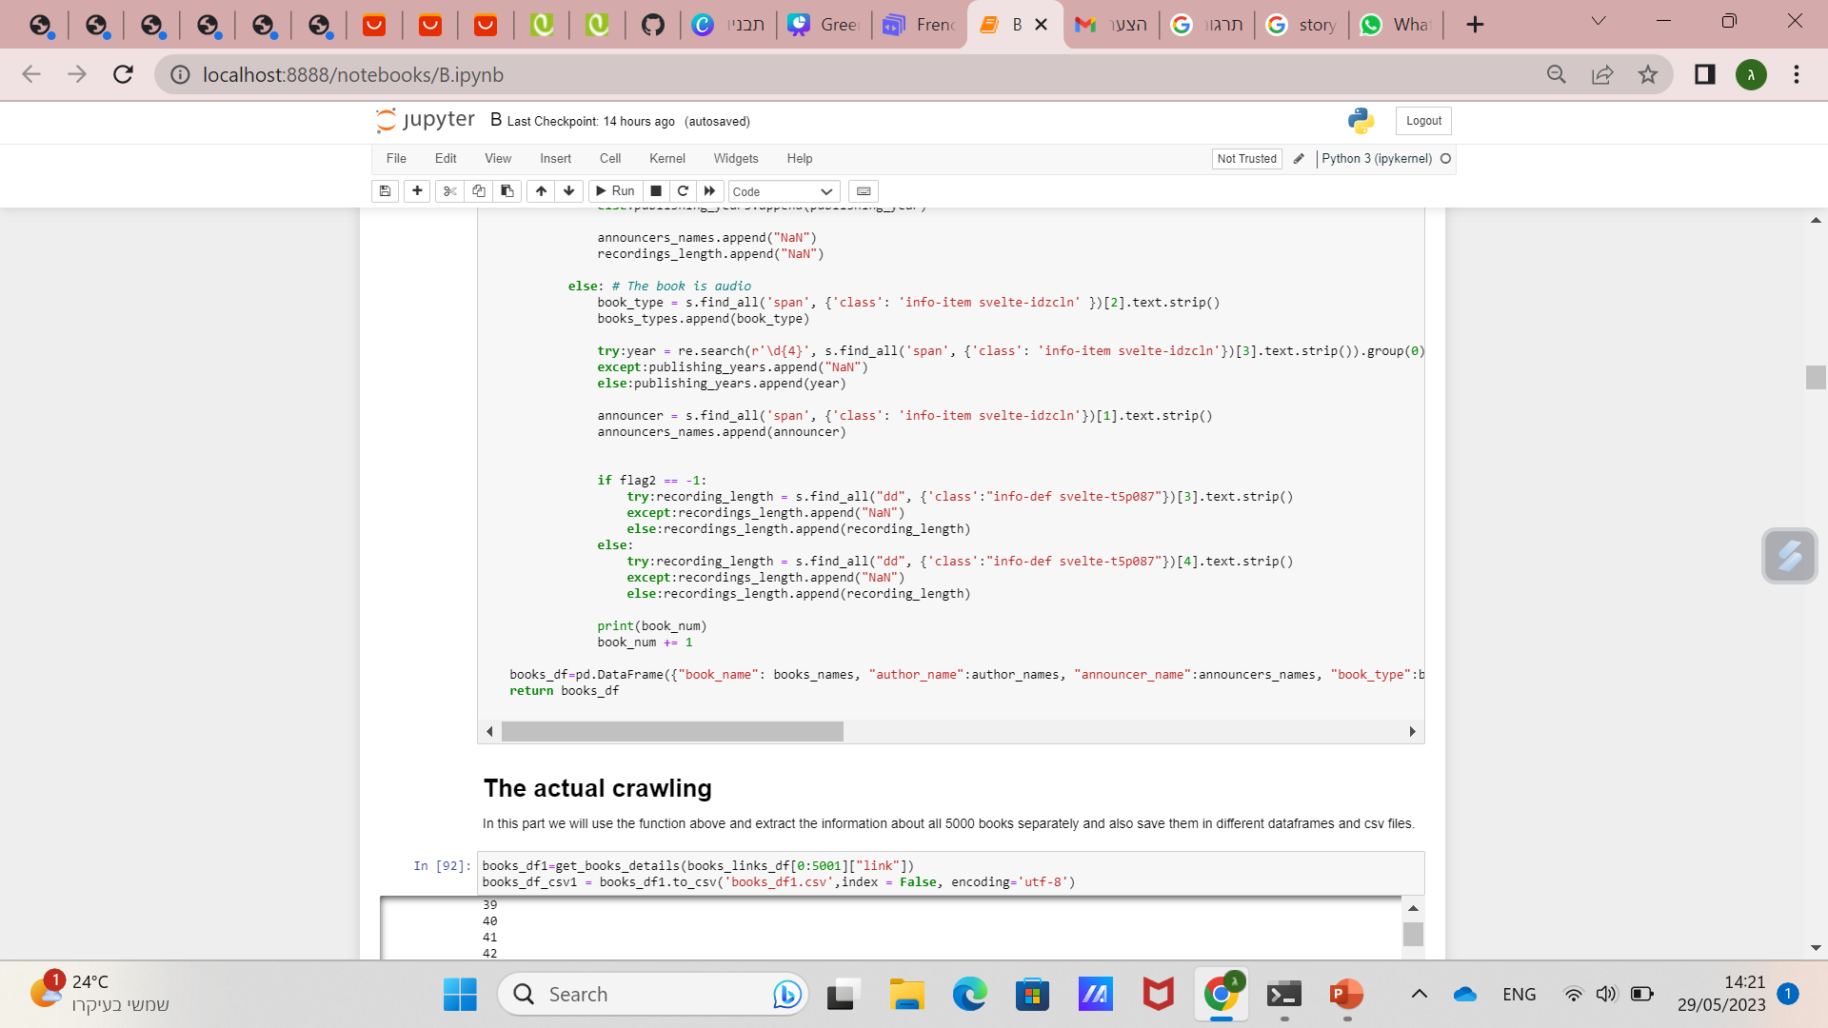
בס"ד
(2)
(1)
Crawling every book page with BeautifulSoup
(3)

Slide 8
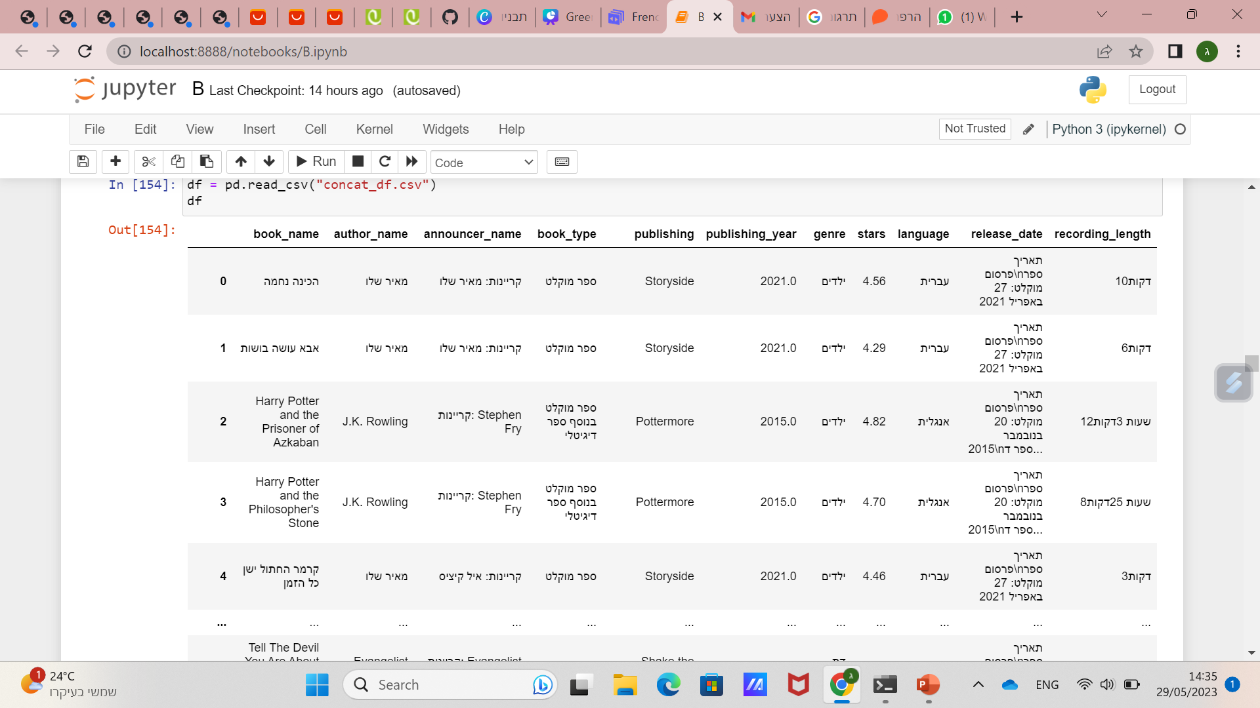
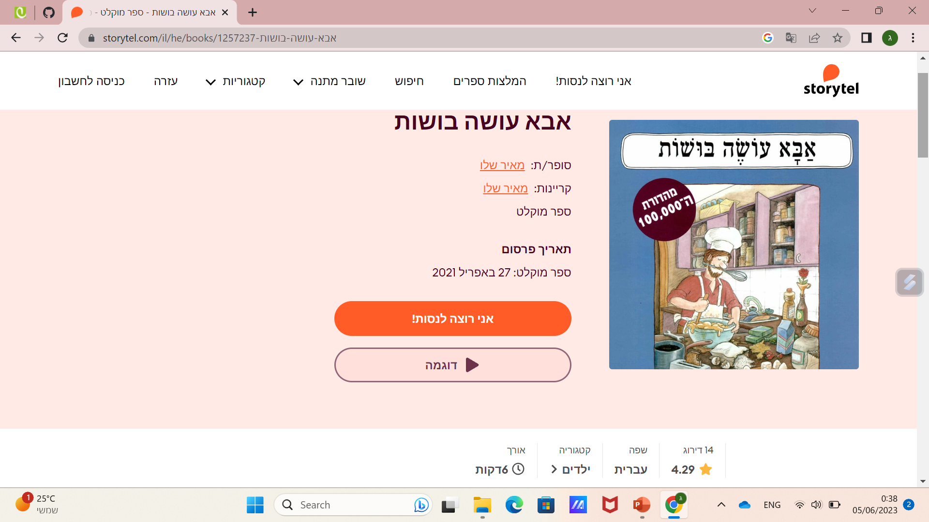
בס"ד
The DataFrame after crawling
In this image we can see most of the crawled features

Slide 9
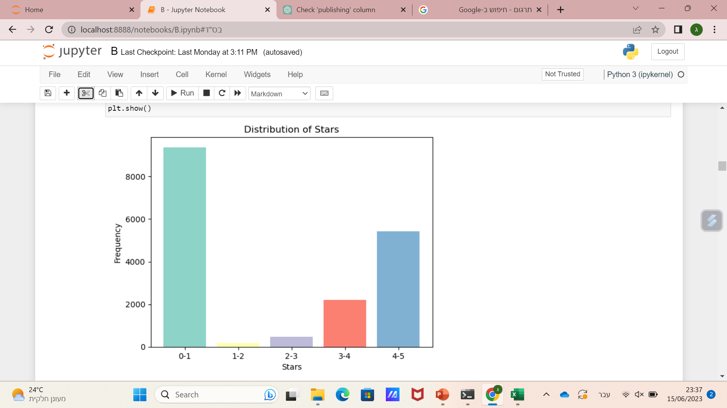
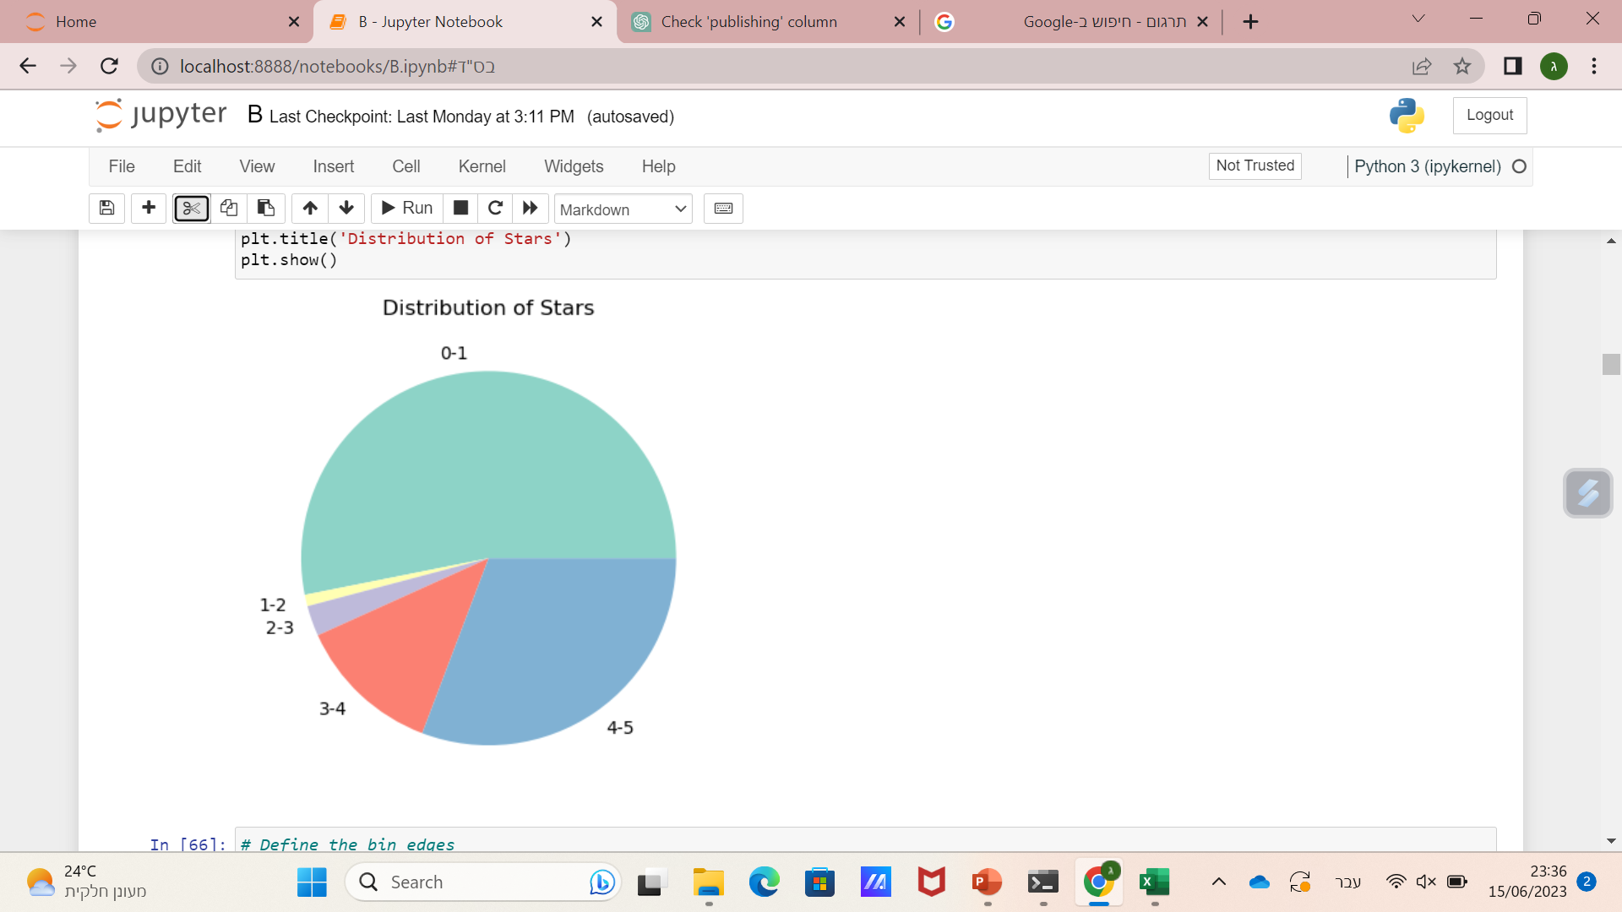
בס"ד
Target column - stars

Slide 10
Data cleaning
בס"ד

Slide 11
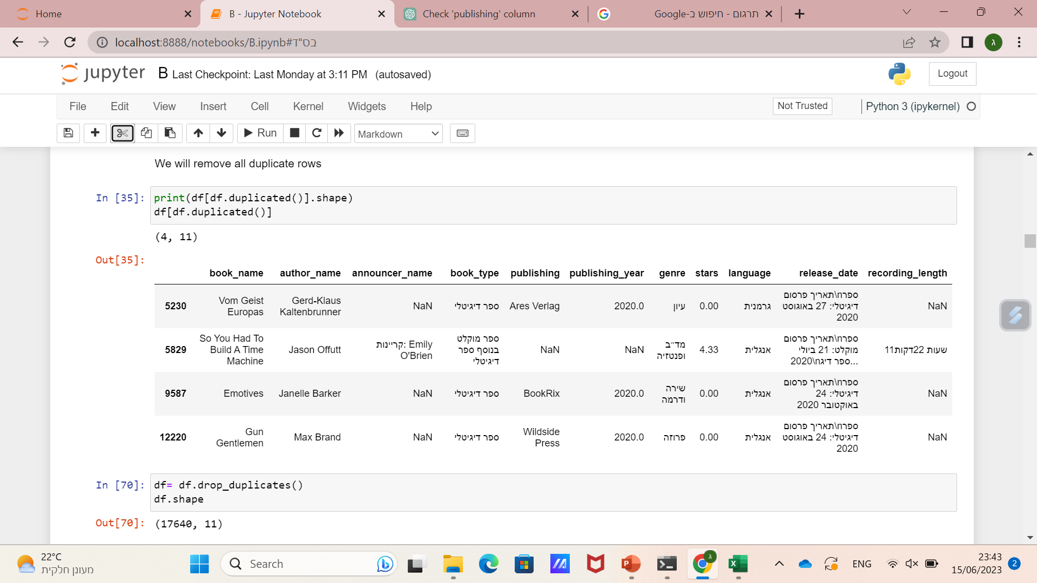
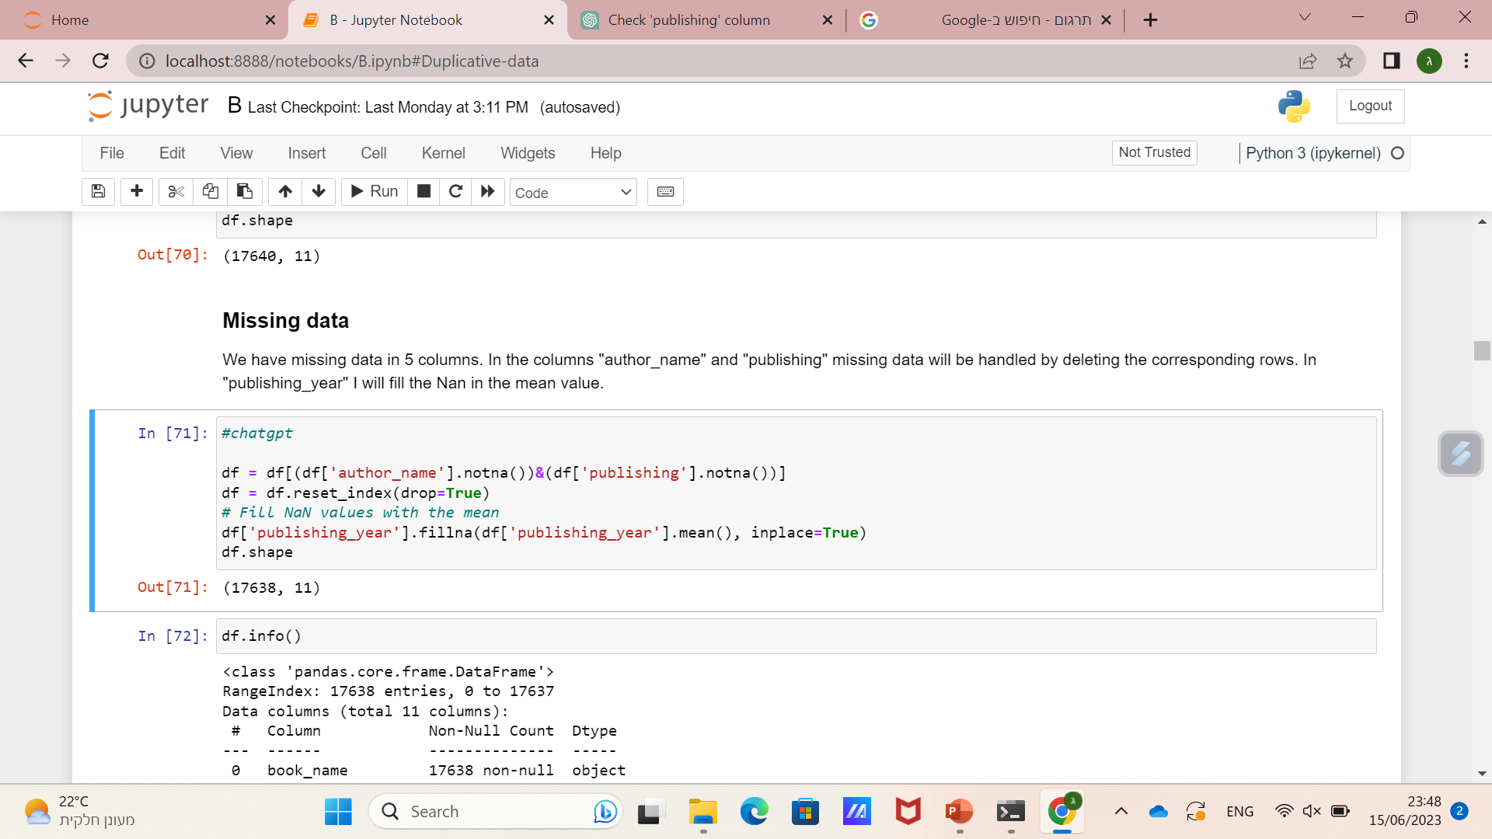
Duplicative data
בס"ד

Slide 12
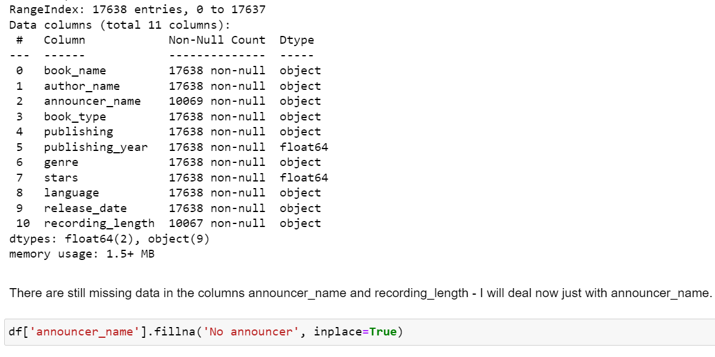
Missing data
בס"ד

Slide 13
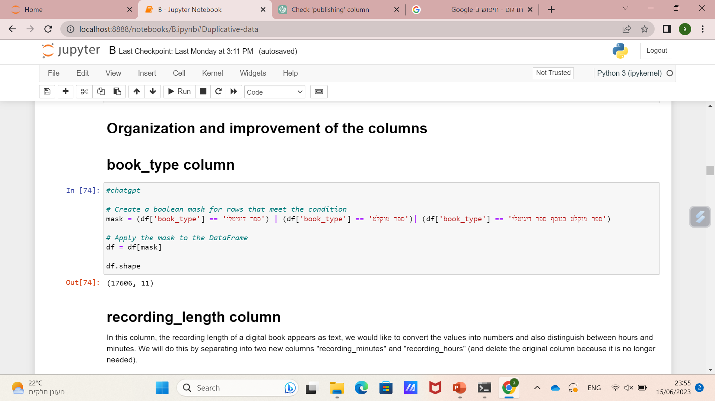
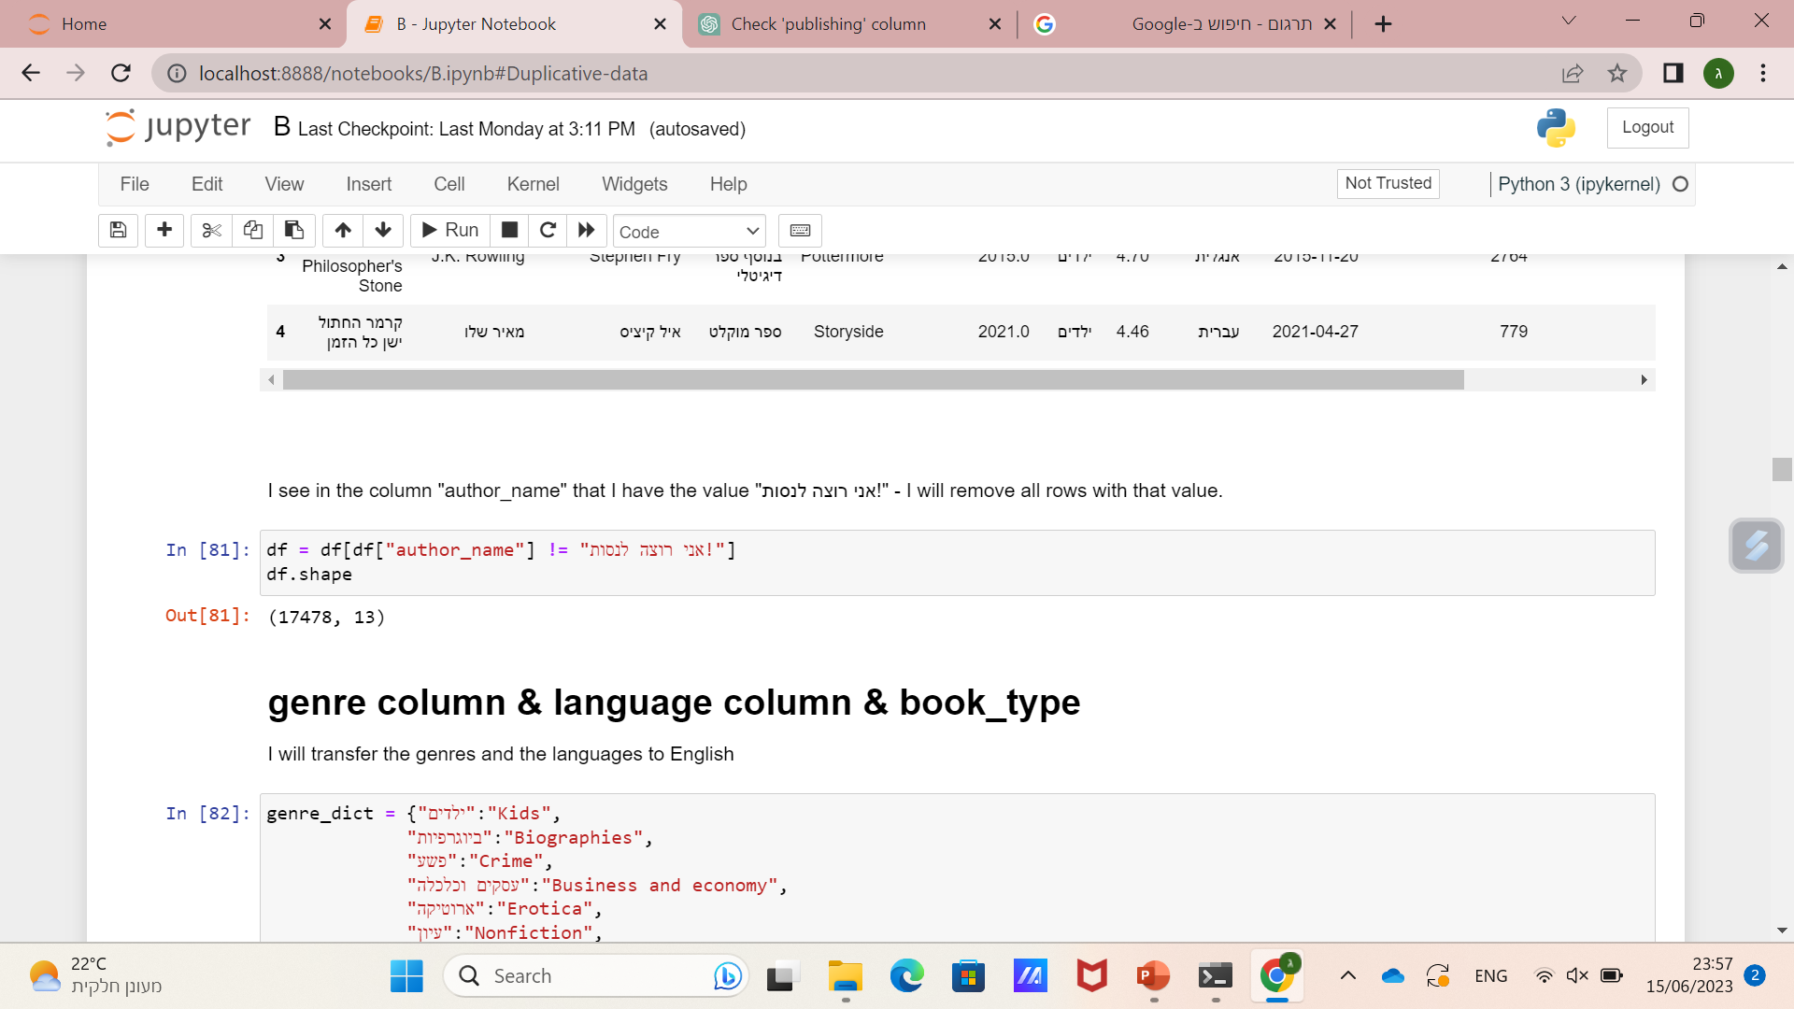
בס"ד
Book_type column
author_name column

Slide 14
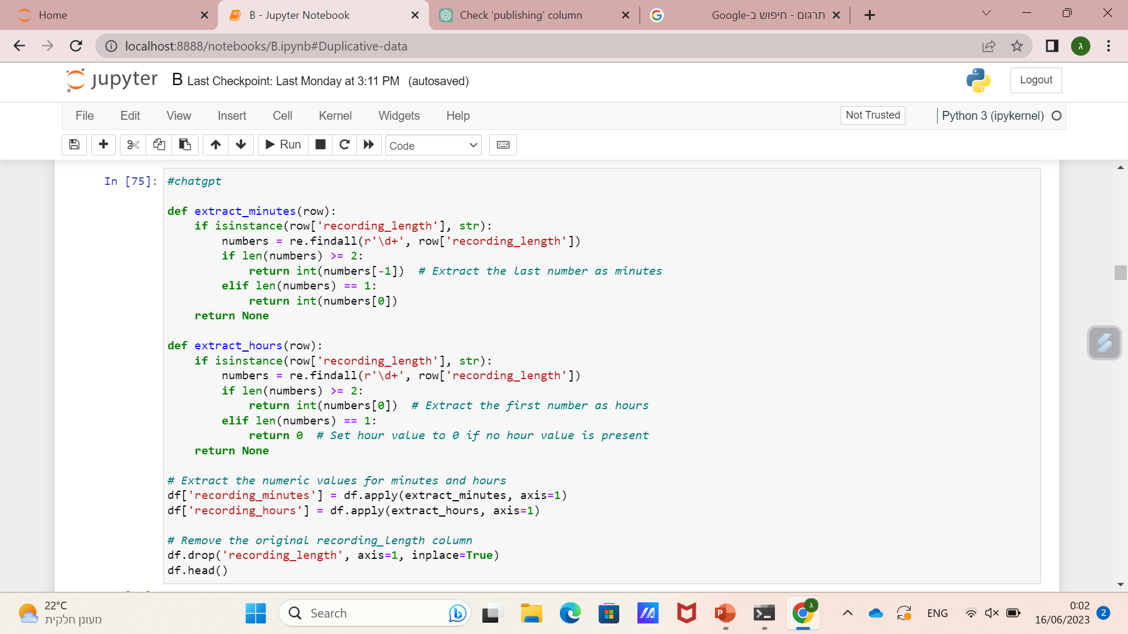
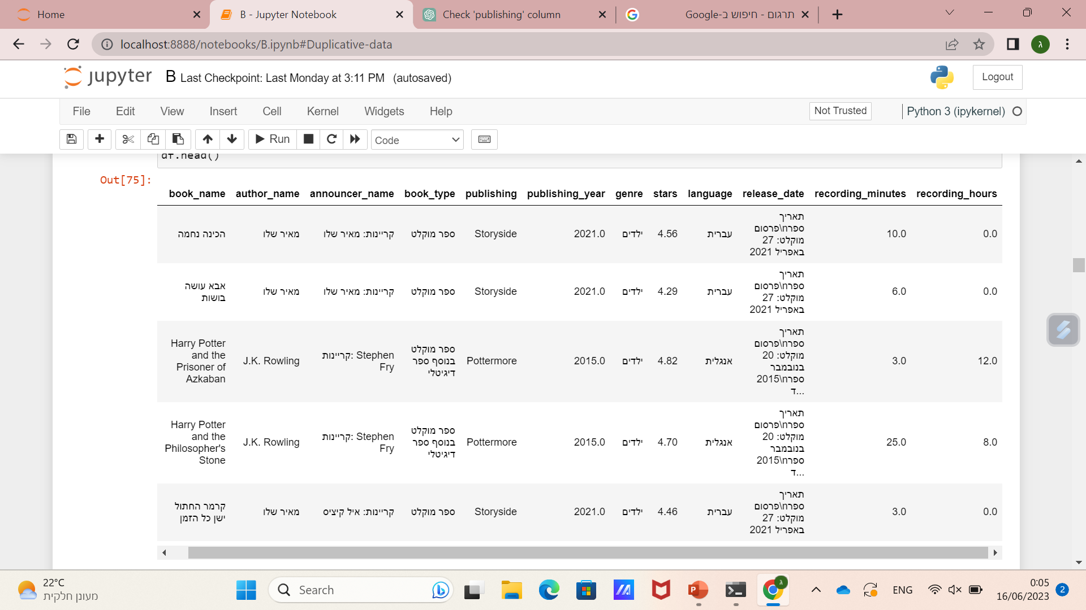
Recording_len column
בס"ד
The new columns
I converted the data to numbers and split this column into two new columns

Slide 15
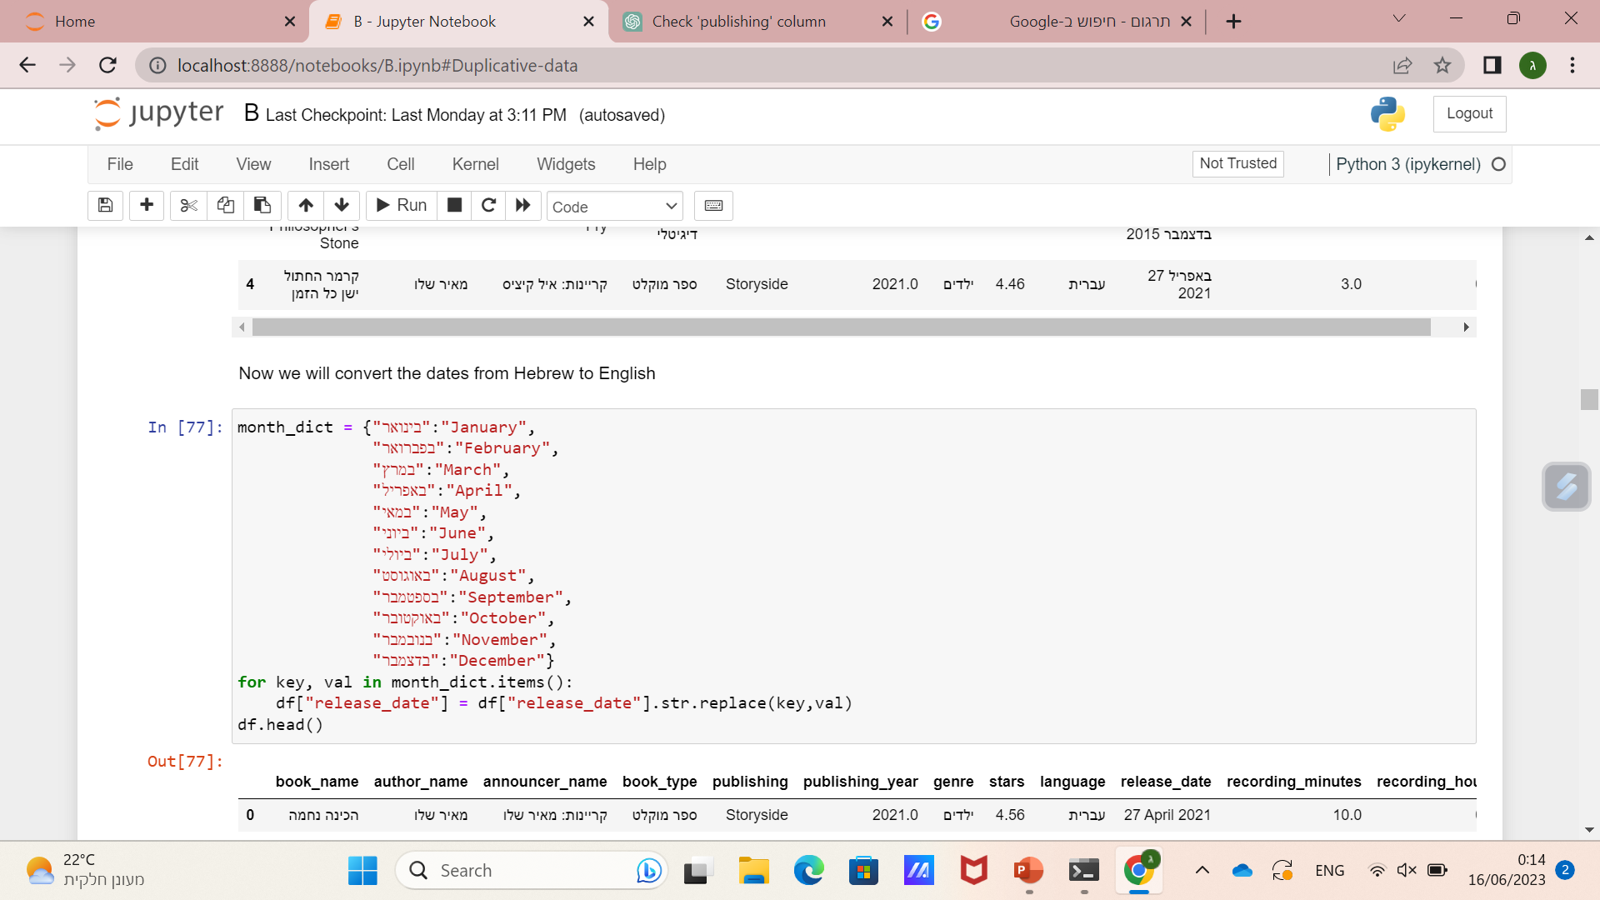
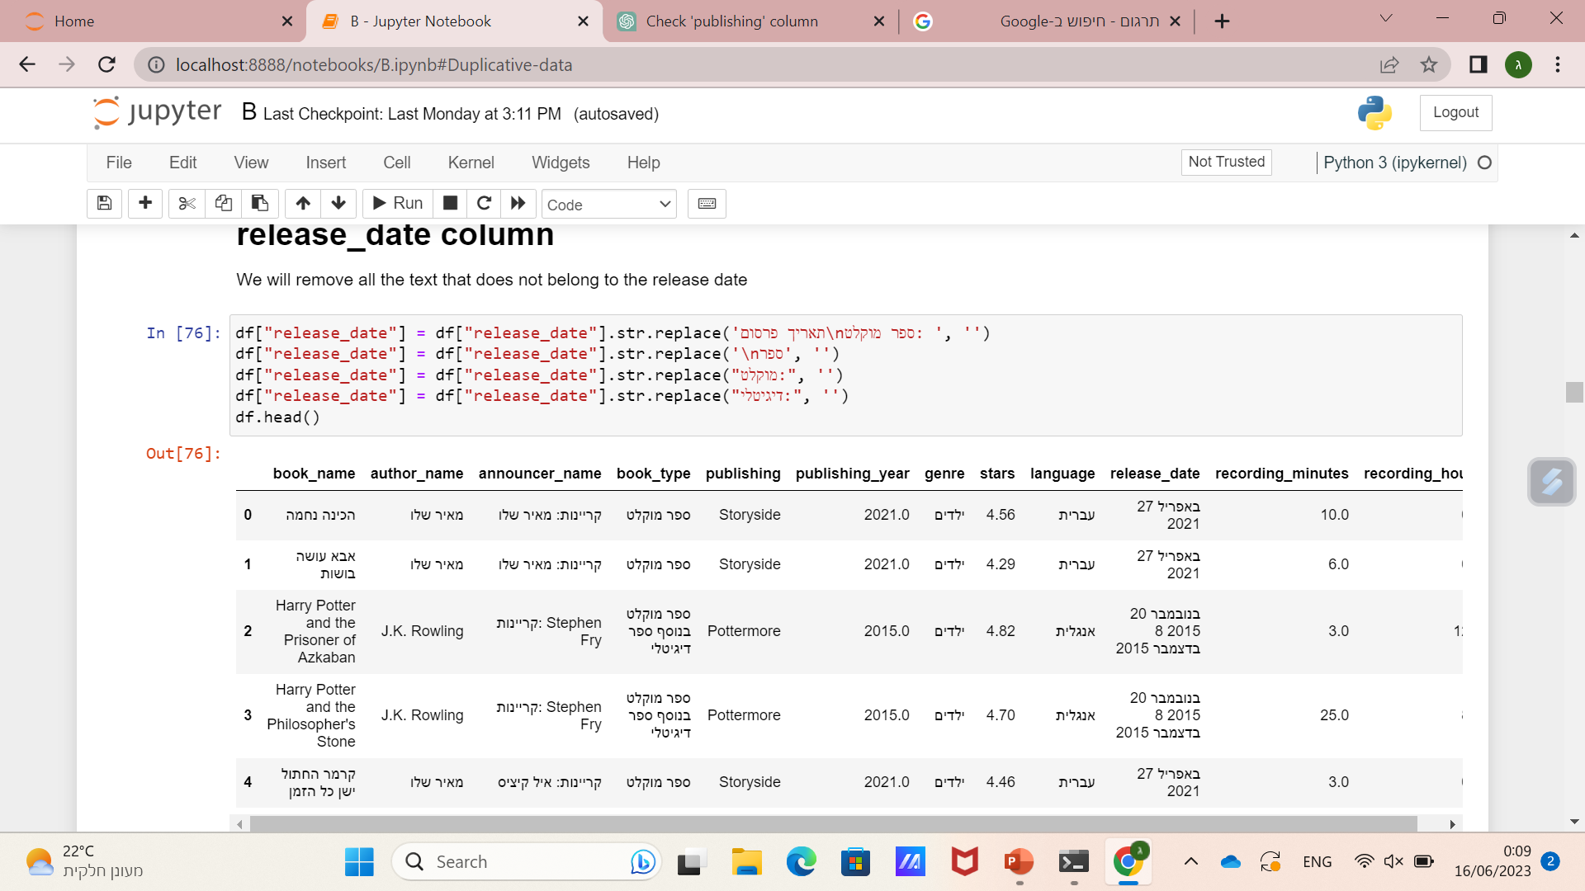
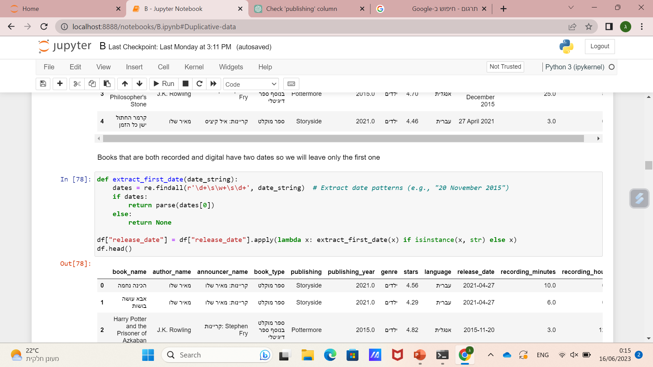
release_date column
בס"ד
I removed unnecessary text
(2)
(1)
Books that are both recorded and digital have two dates so I kept the first and converted from string to date format
(3)

Slide 16
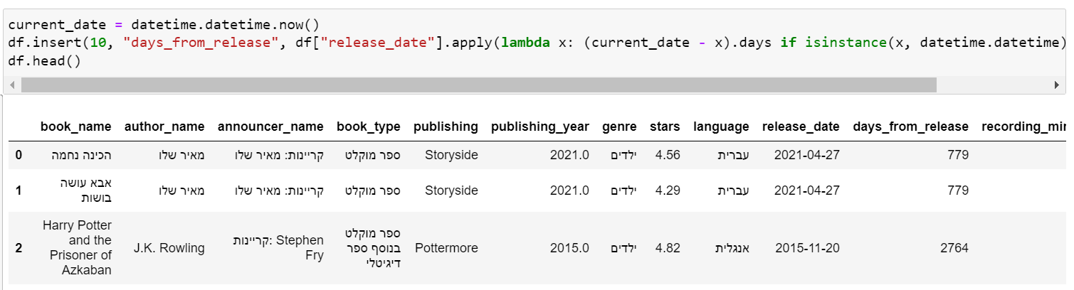
release_date column
בס"ד
I created a new column that represents the number of days that have passed from the release date to the 15/6/23.

Slide 17
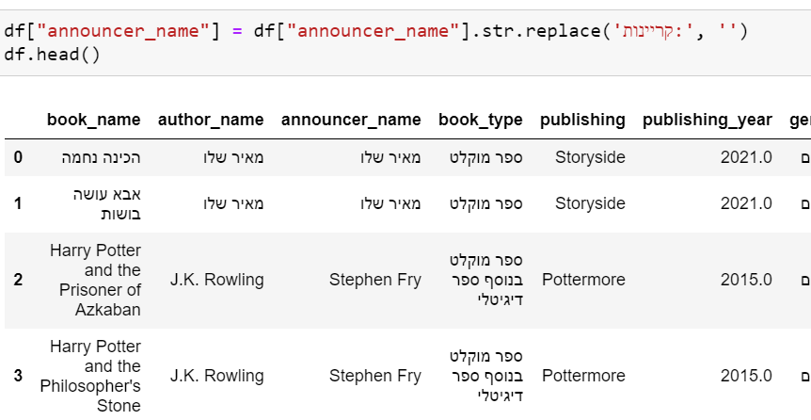
announcer_name column
בס"ד
Remove unnecessary text

Slide 18
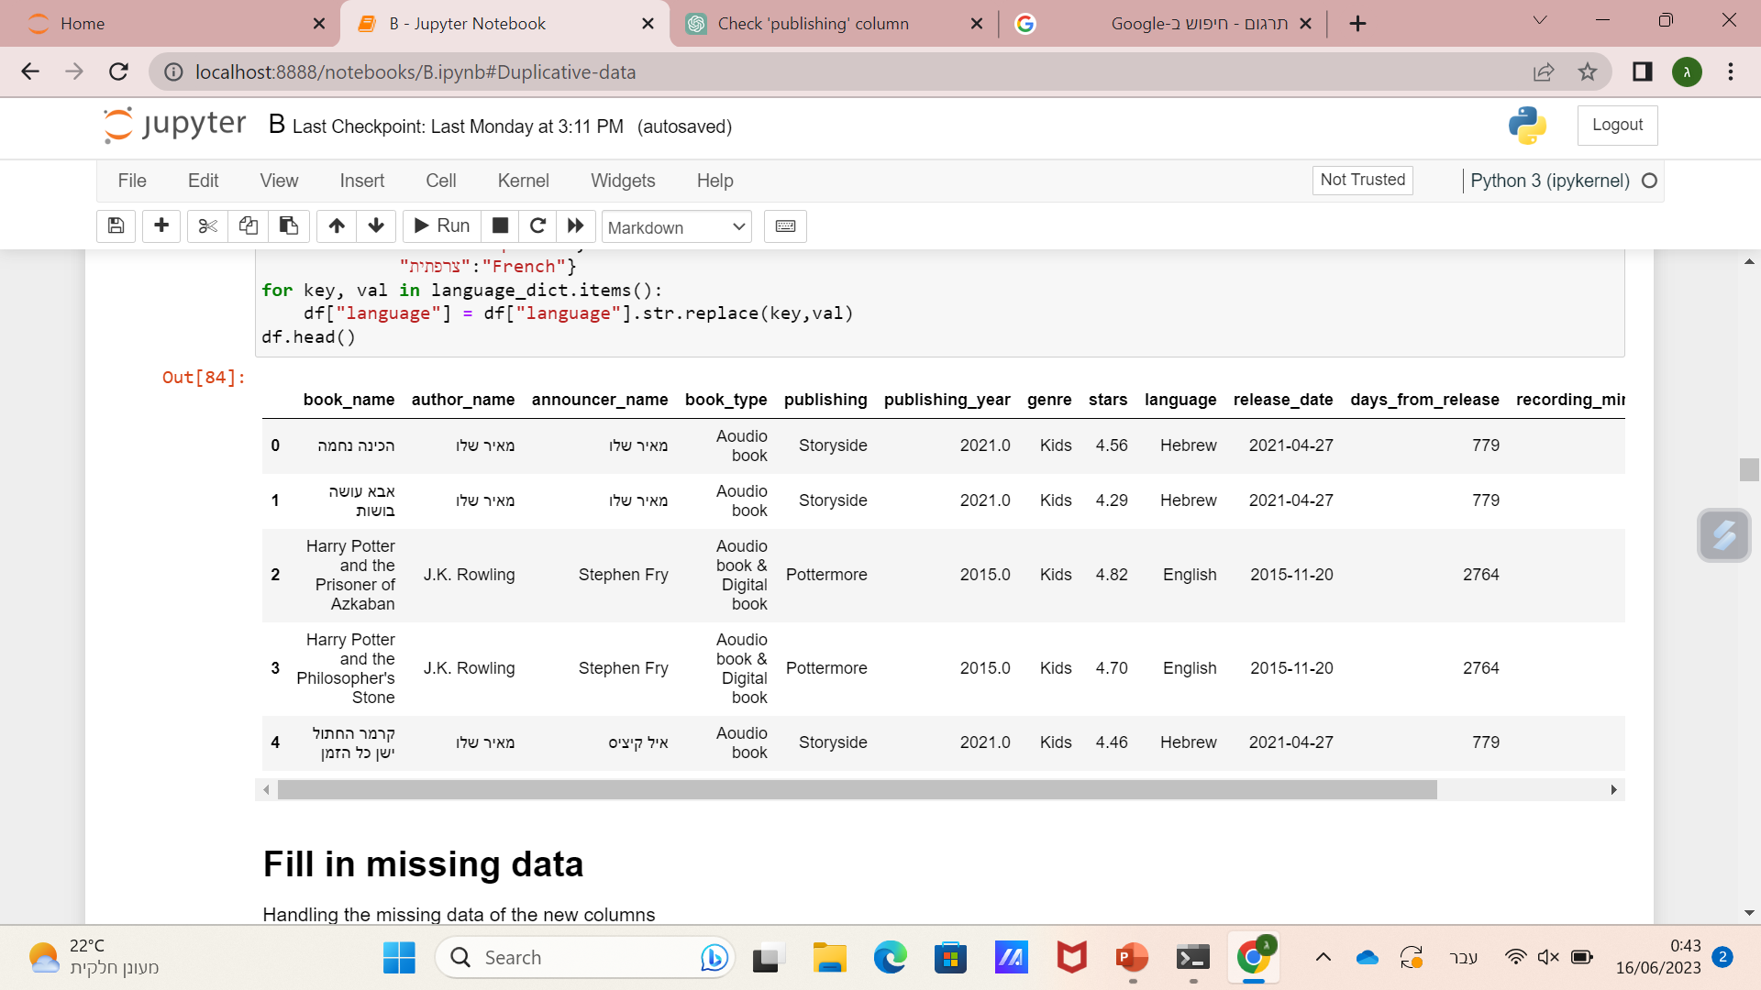
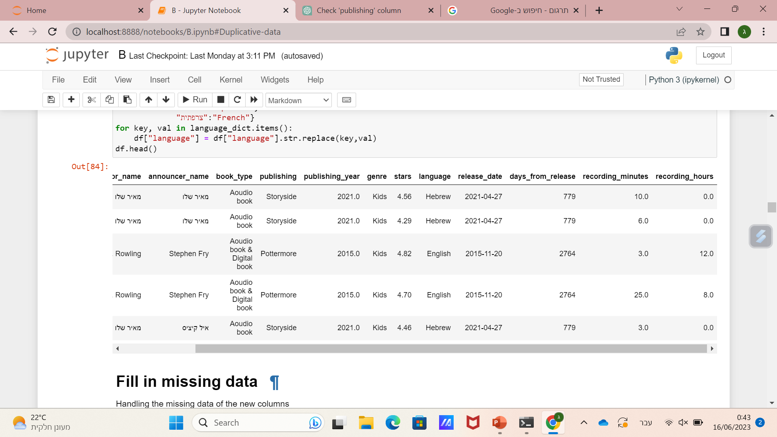
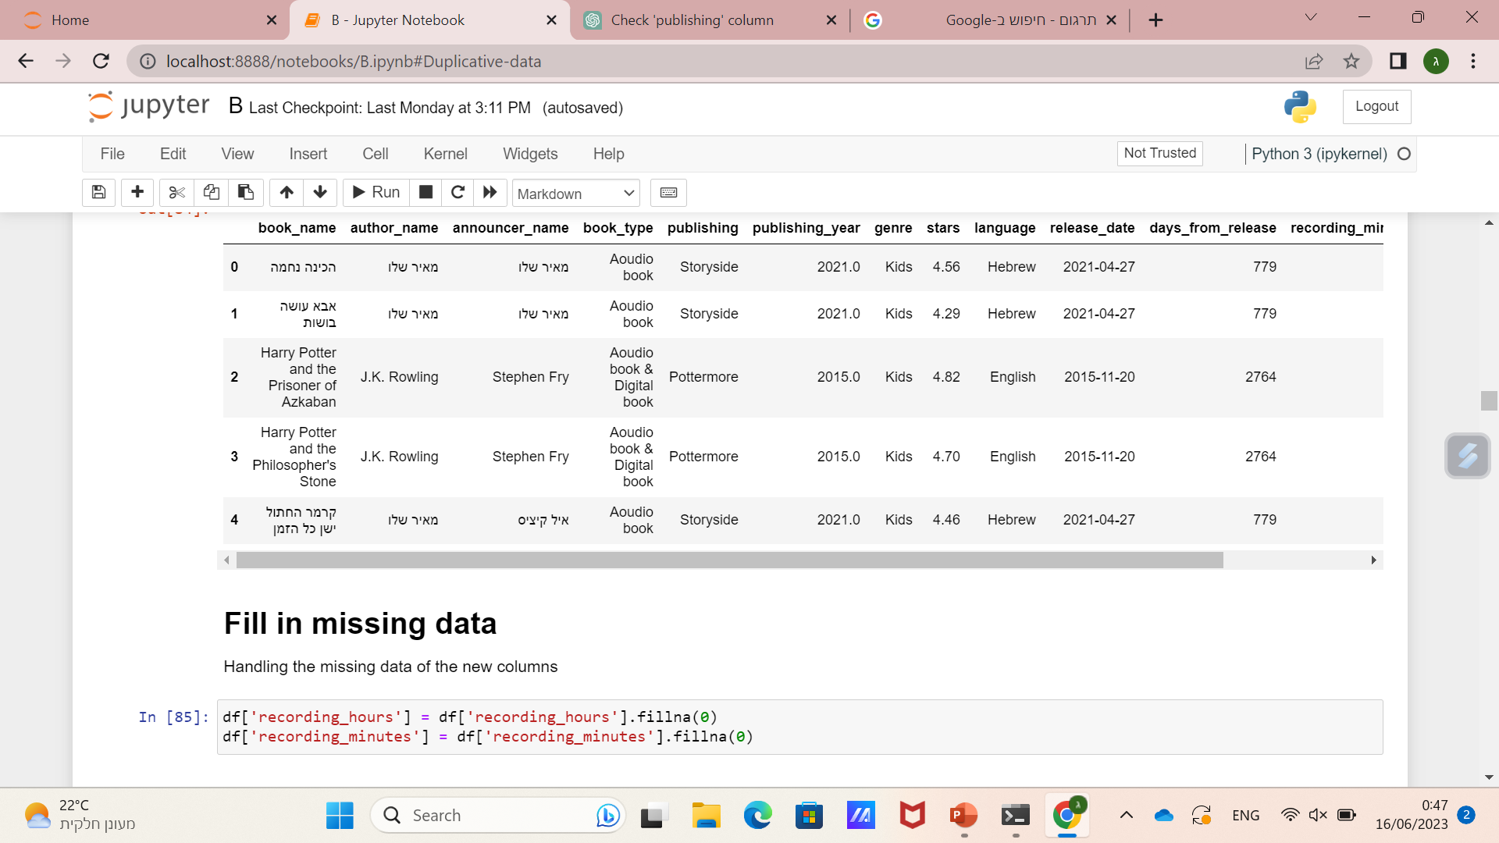
The DataFrame after cleaning
בס"ד
df.shape
(17478, 13)

Slide 19
Visualization & EDA
בס"ד

Slide 20
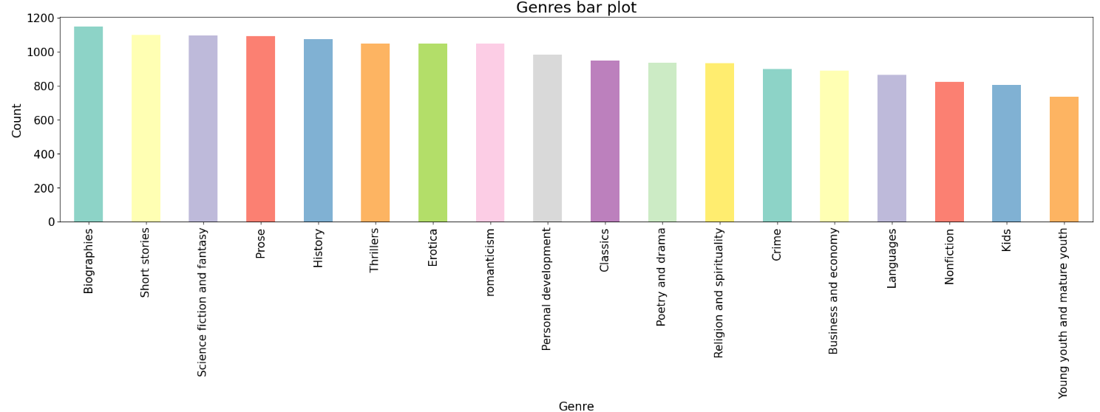
בס"ד

Slide 21
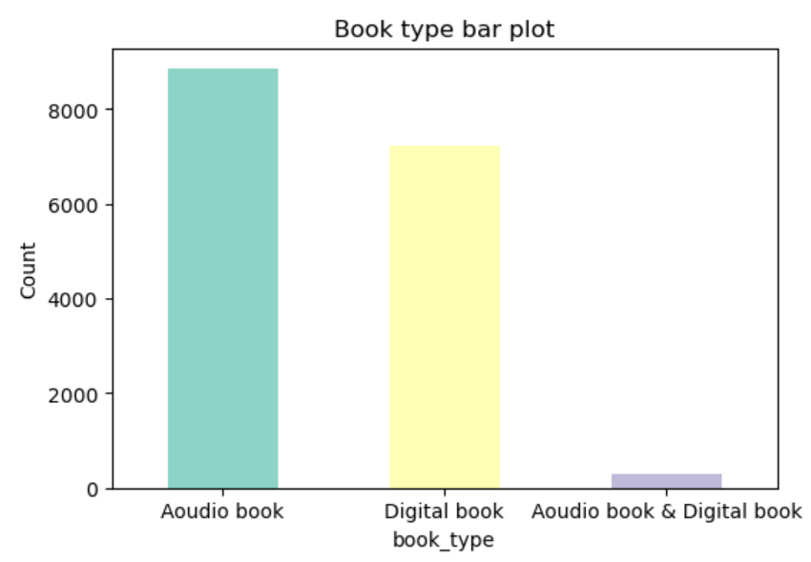
בס"ד

Slide 22
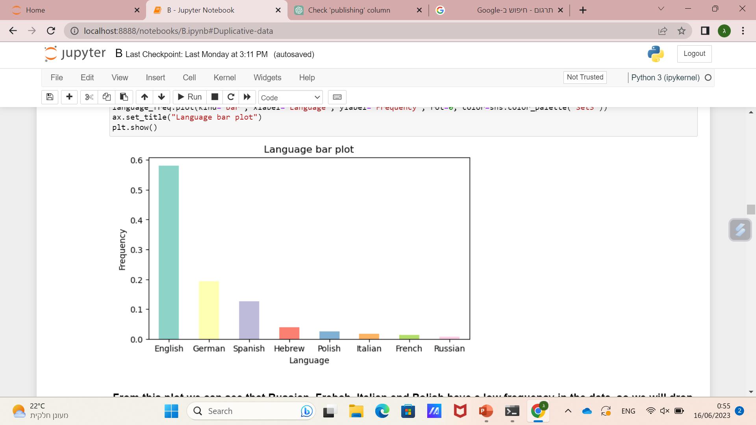
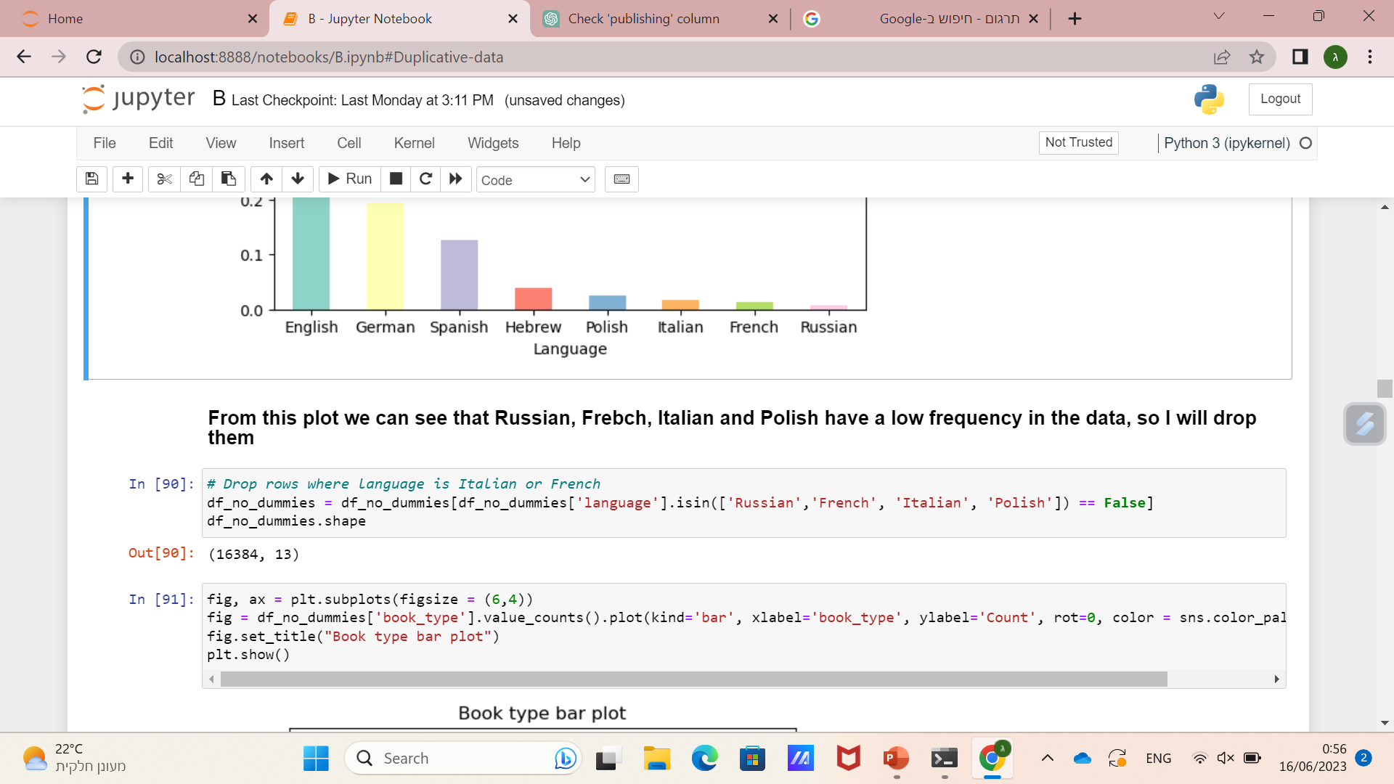
בס"ד

Slide 23
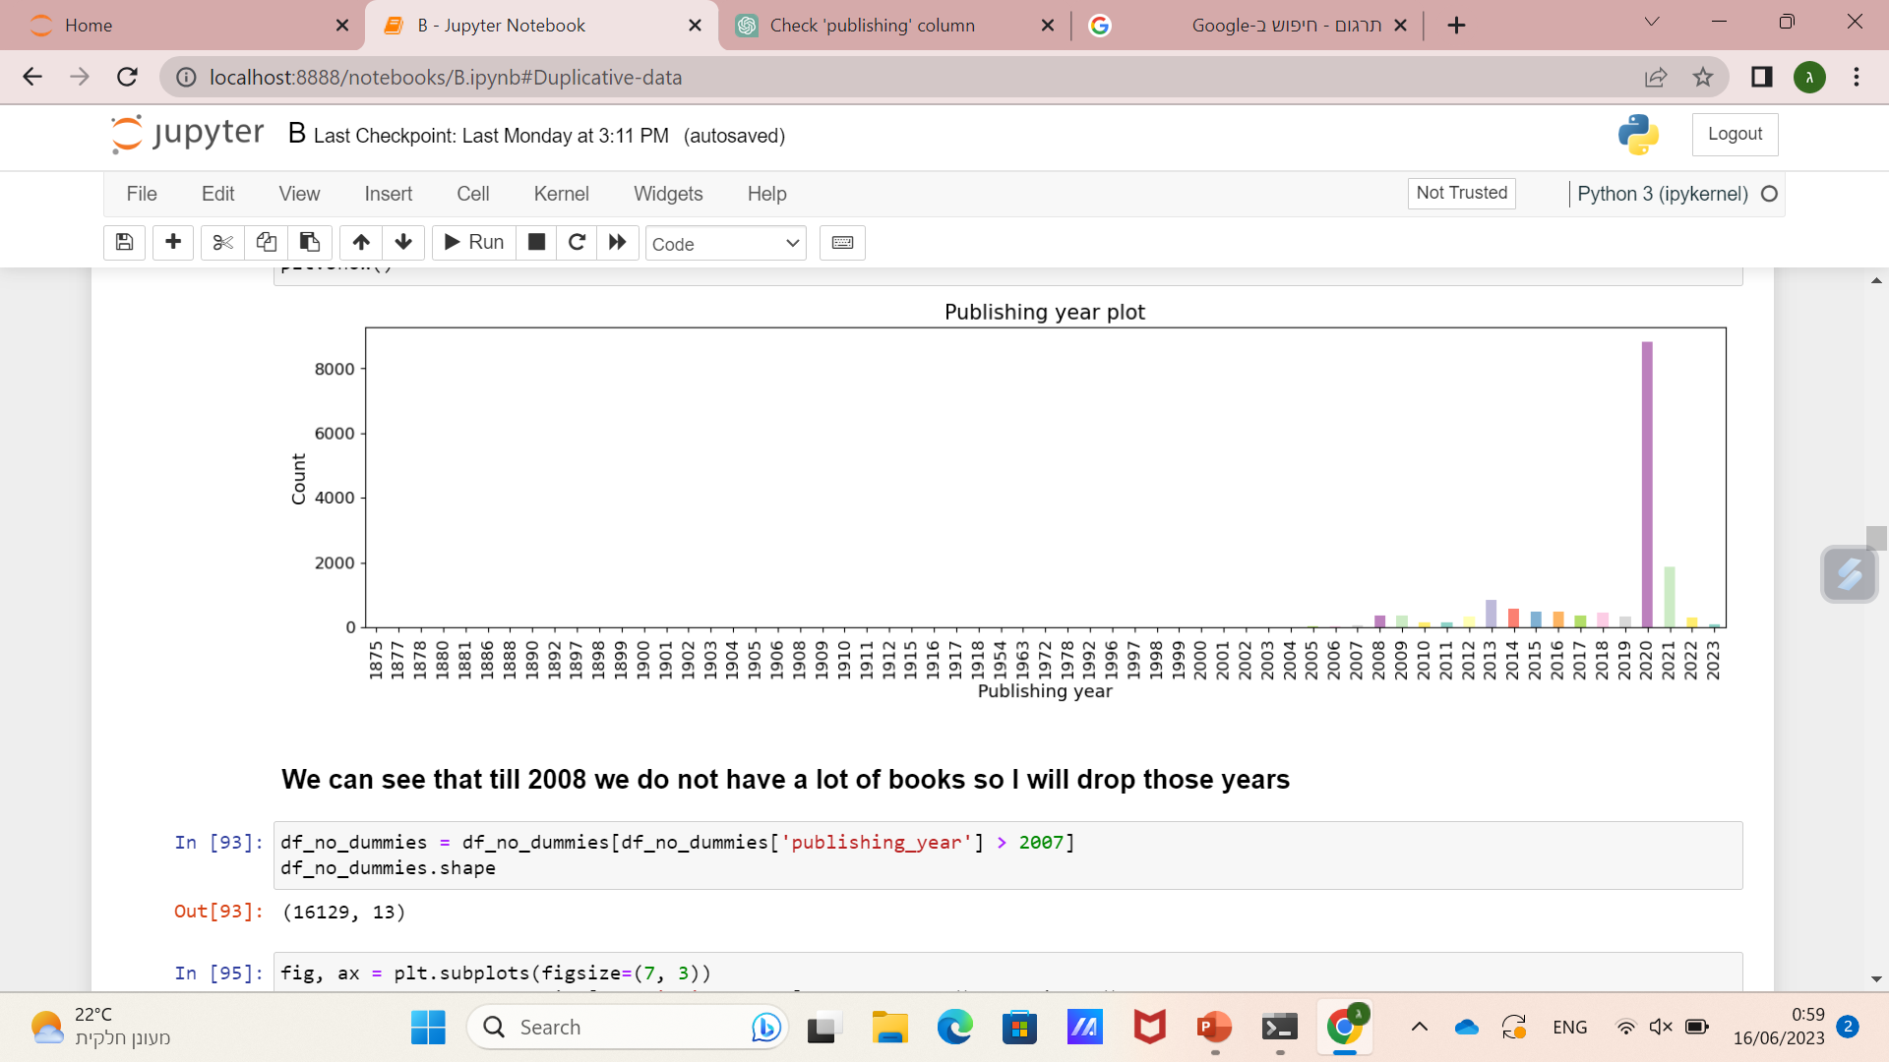
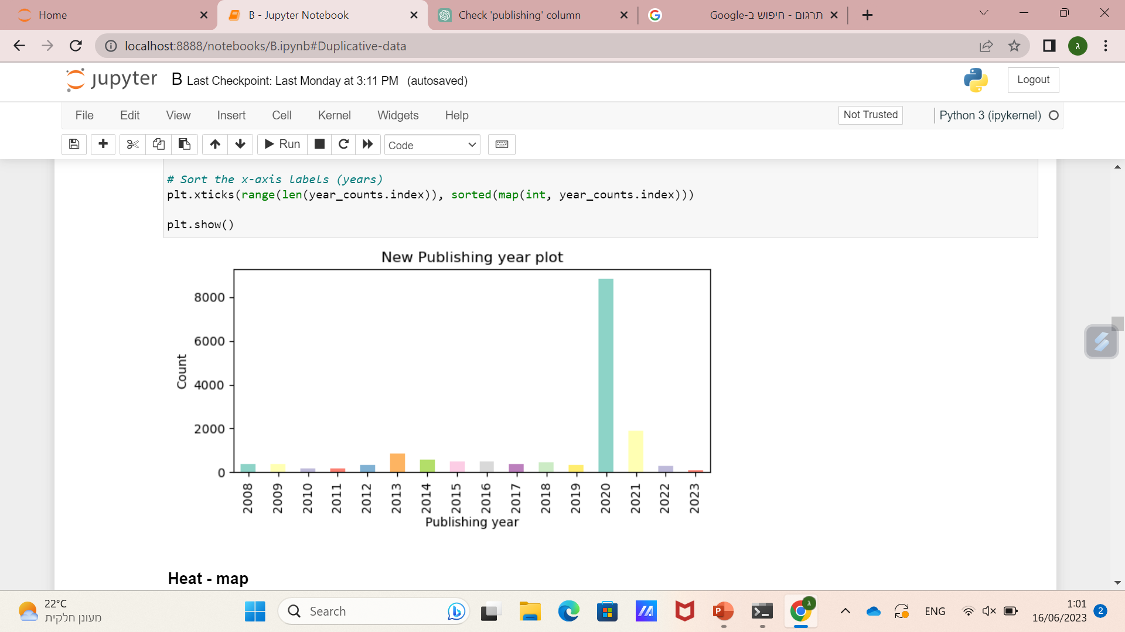
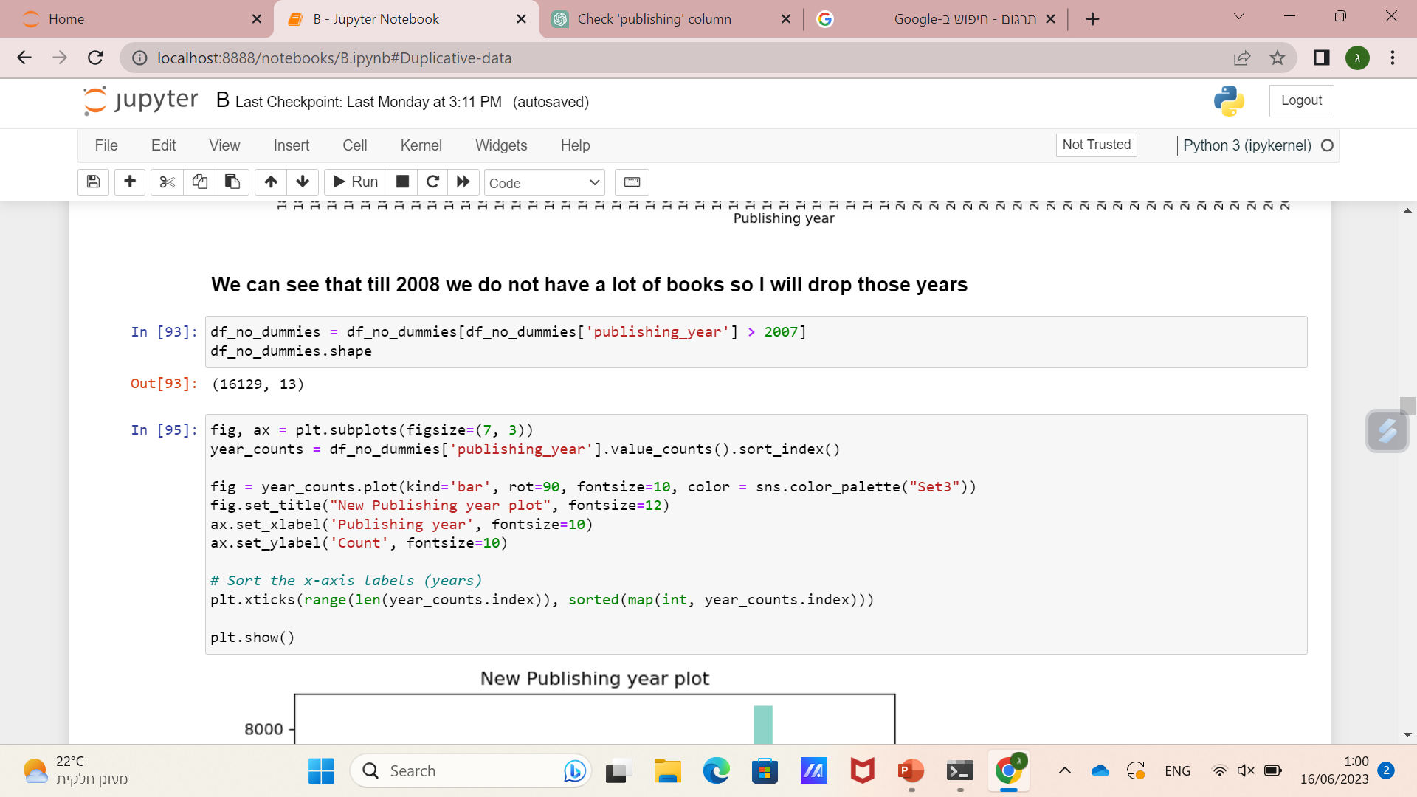
בס"ד

Slide 24
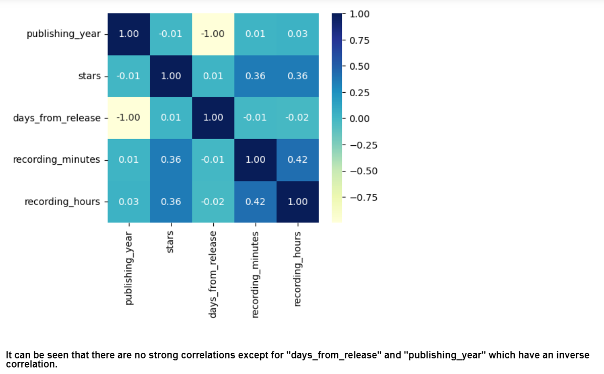
Heat map
בס"ד

Slide 25
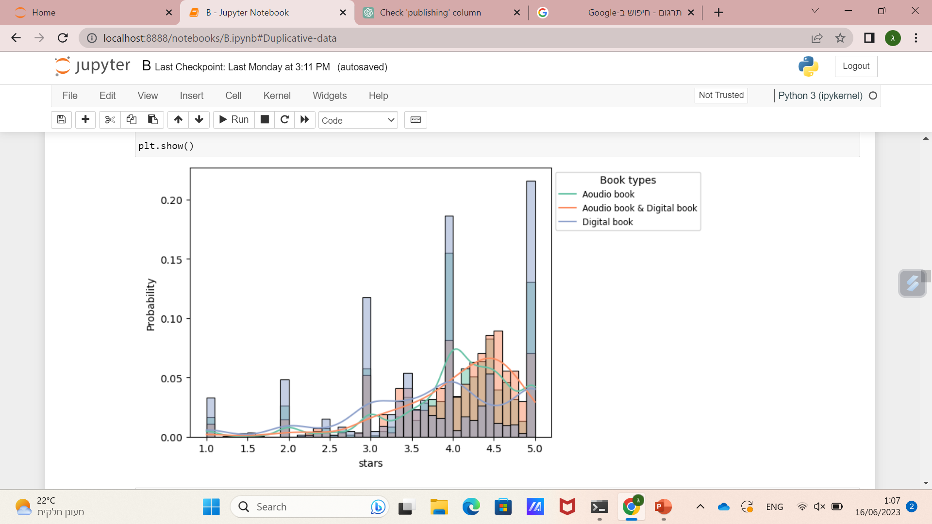
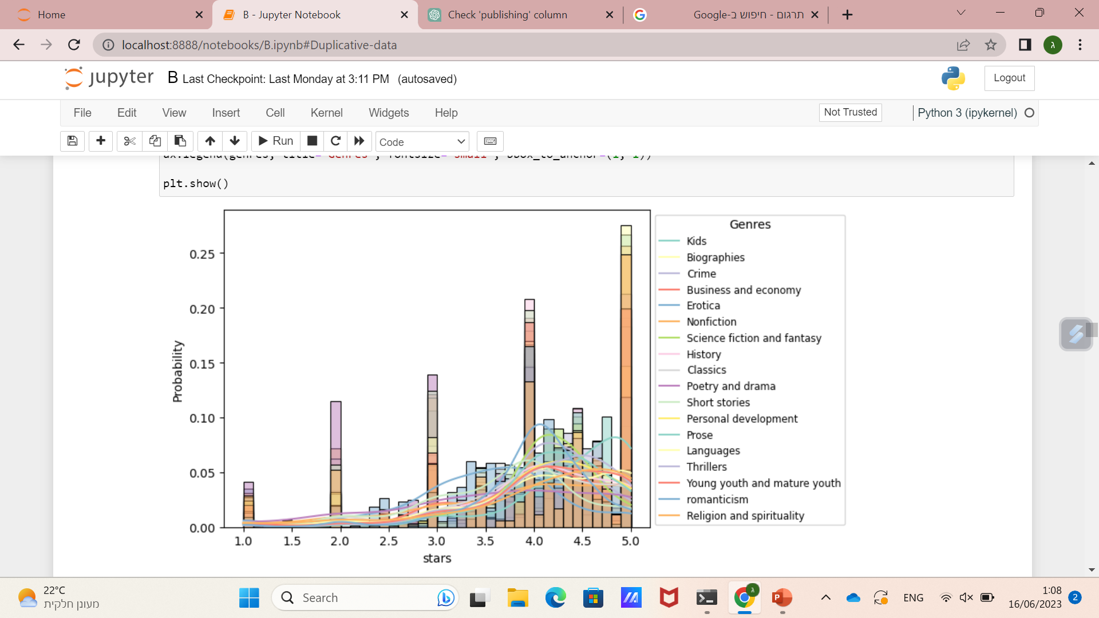
בס"ד

Slide 26
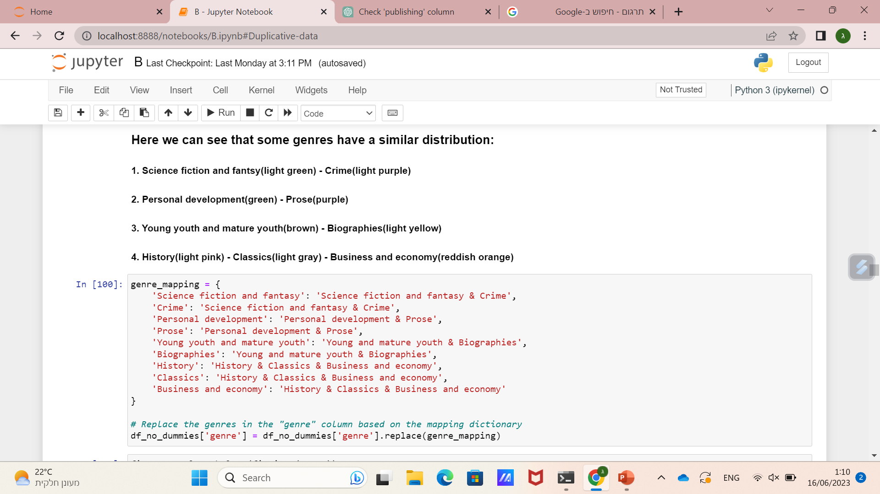
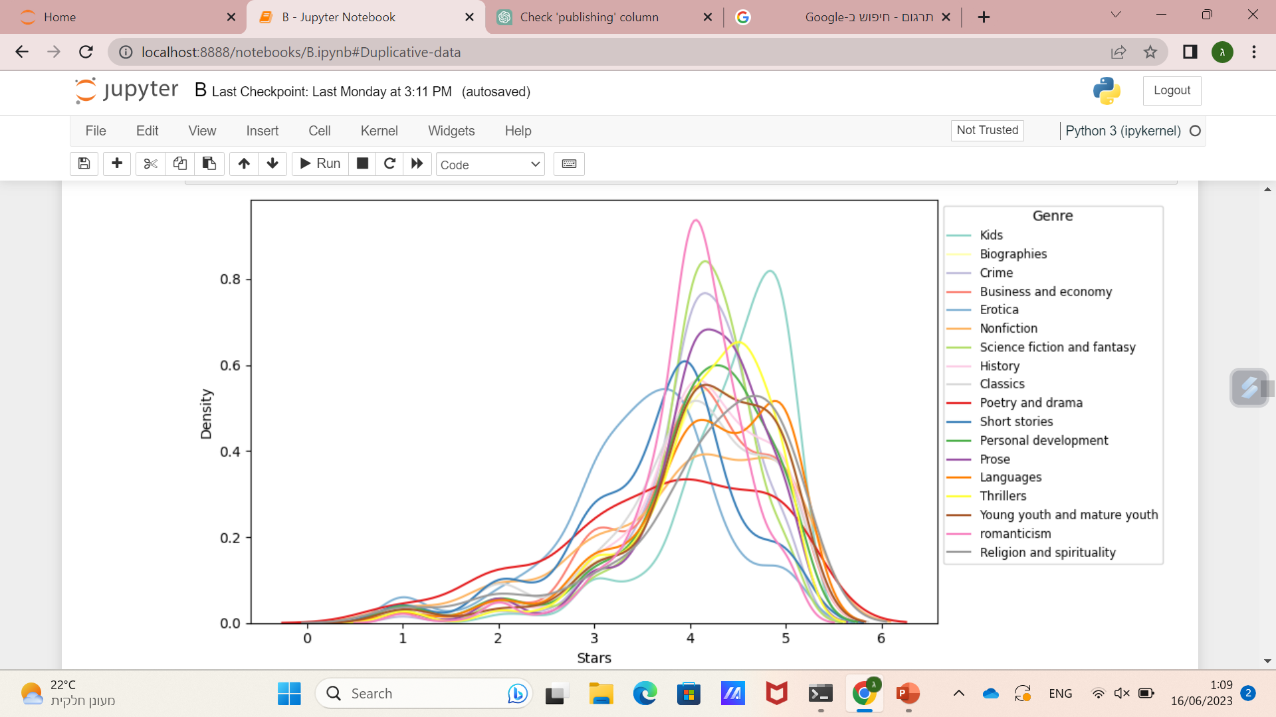
בס"ד

Slide 27
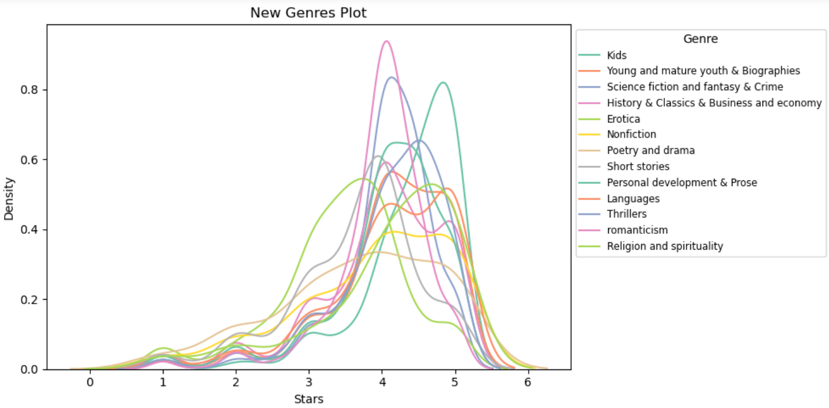
בס"ד

Slide 28
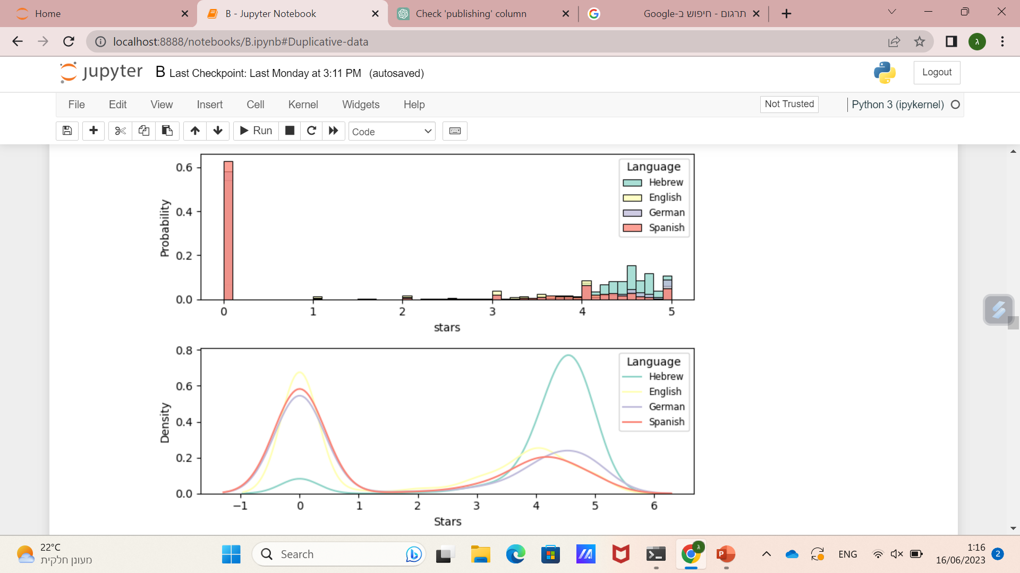
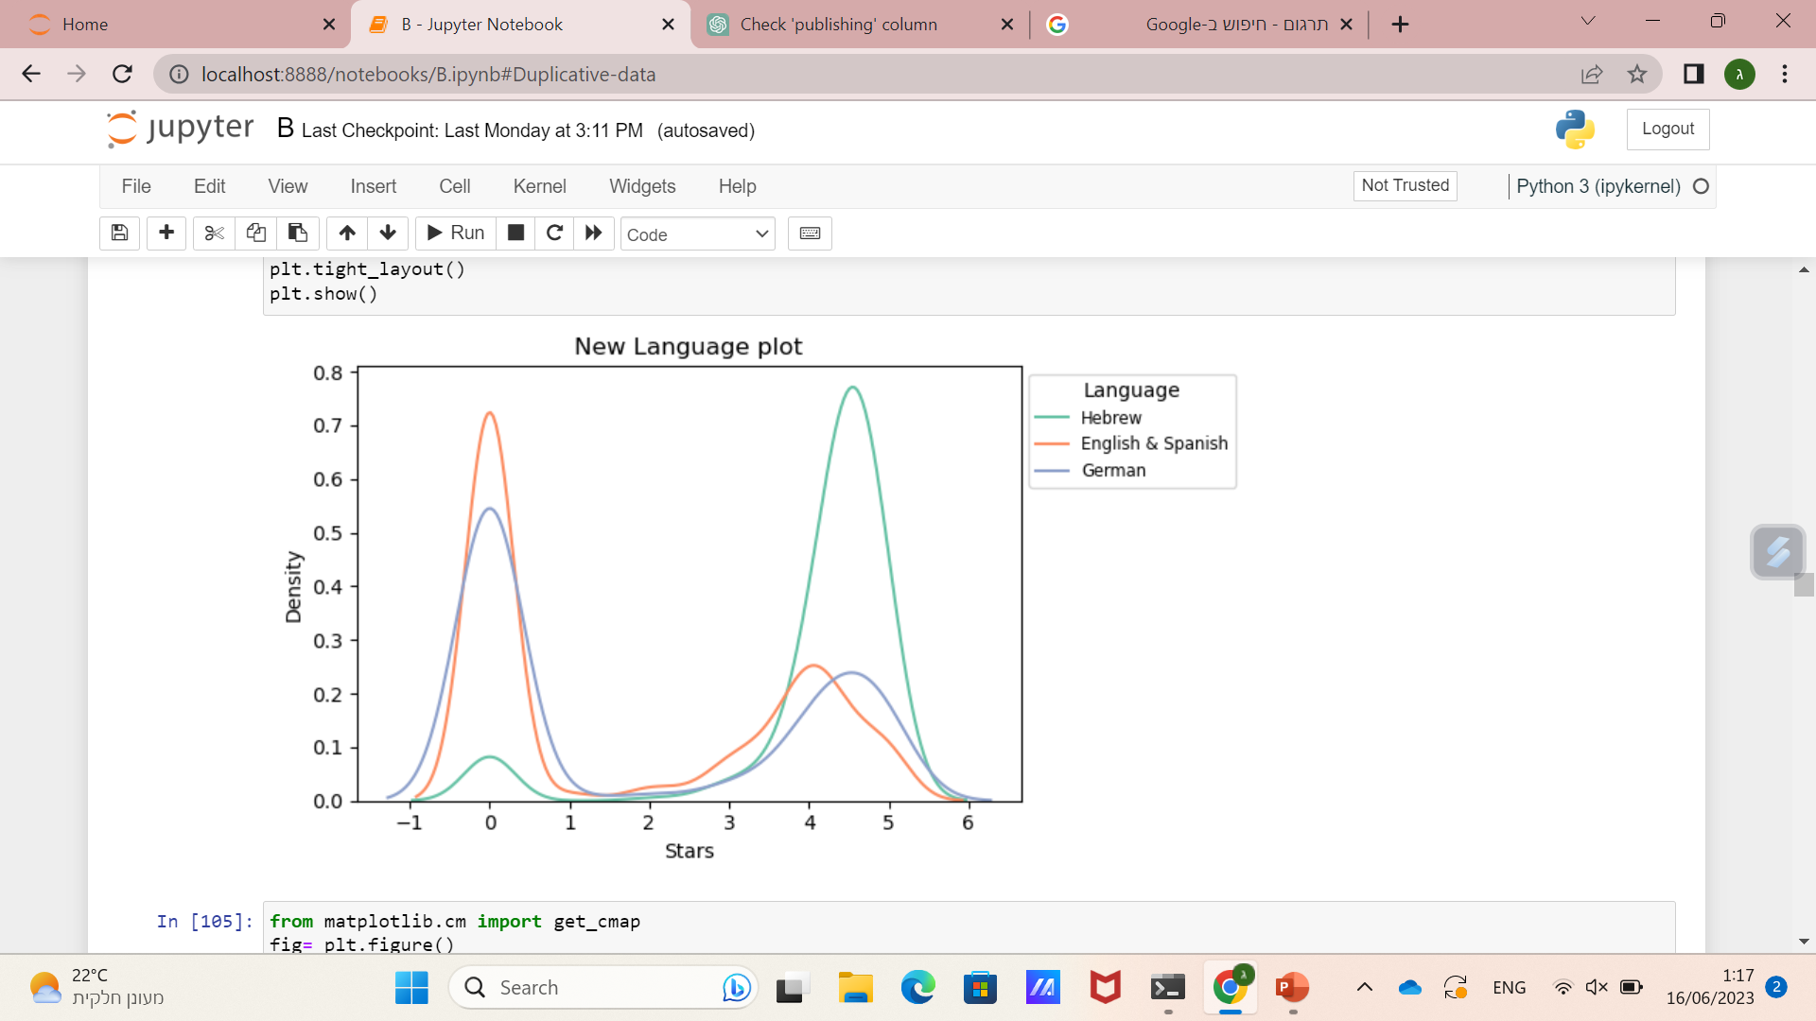
בס"ד
Spanish is distributed similarly to English

Slide 29
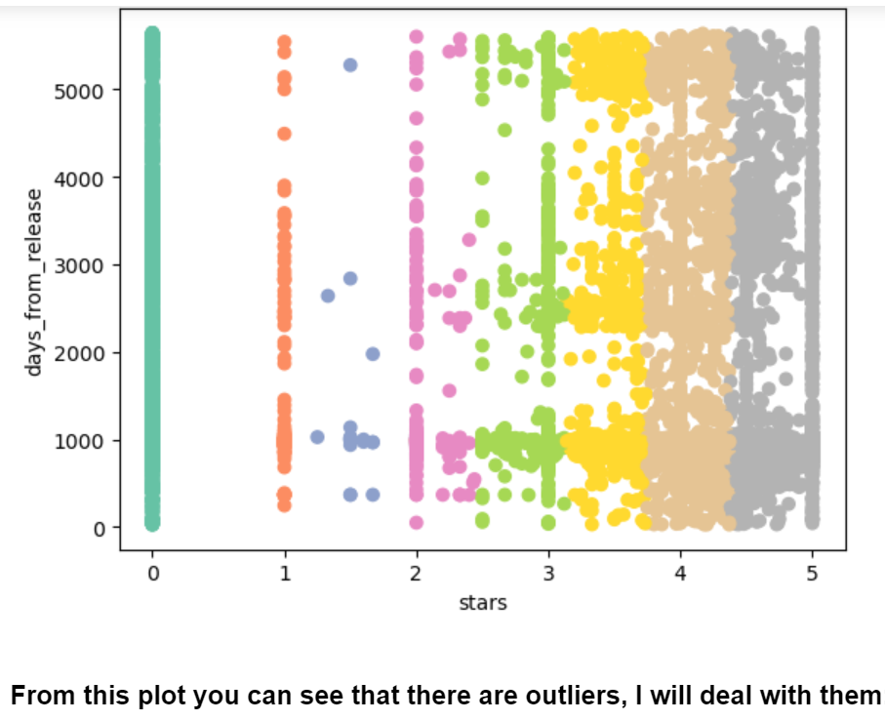
בס"ד

Slide 30
Outliers
בס"ד

Slide 31
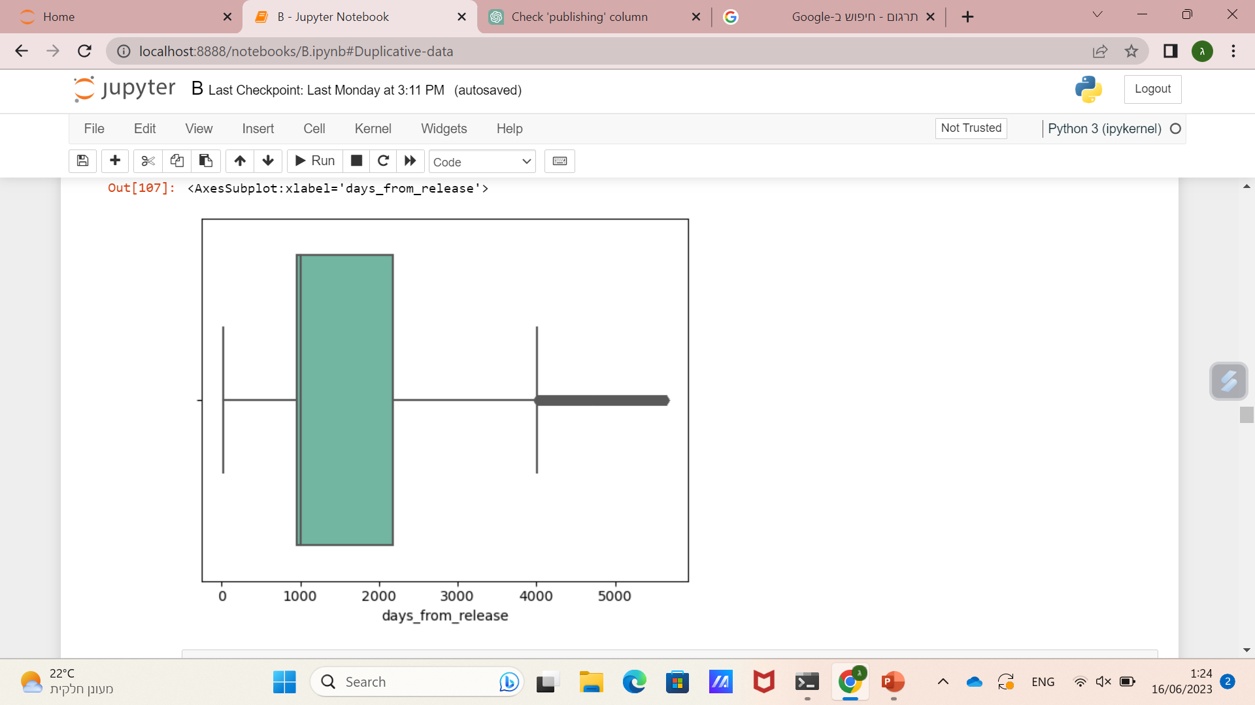
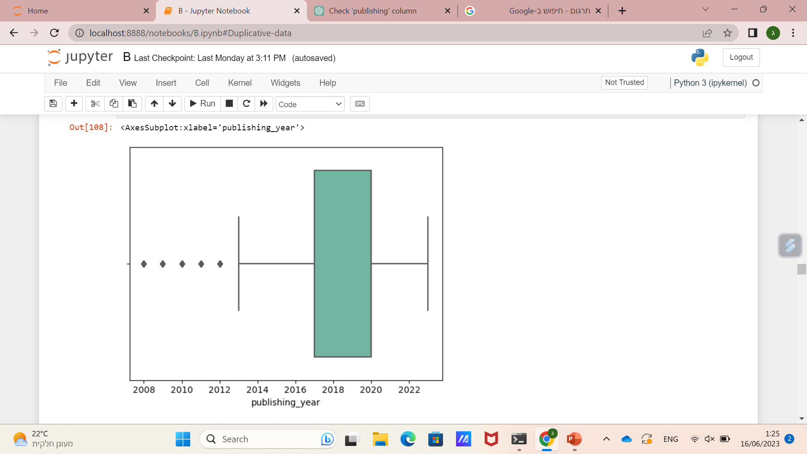
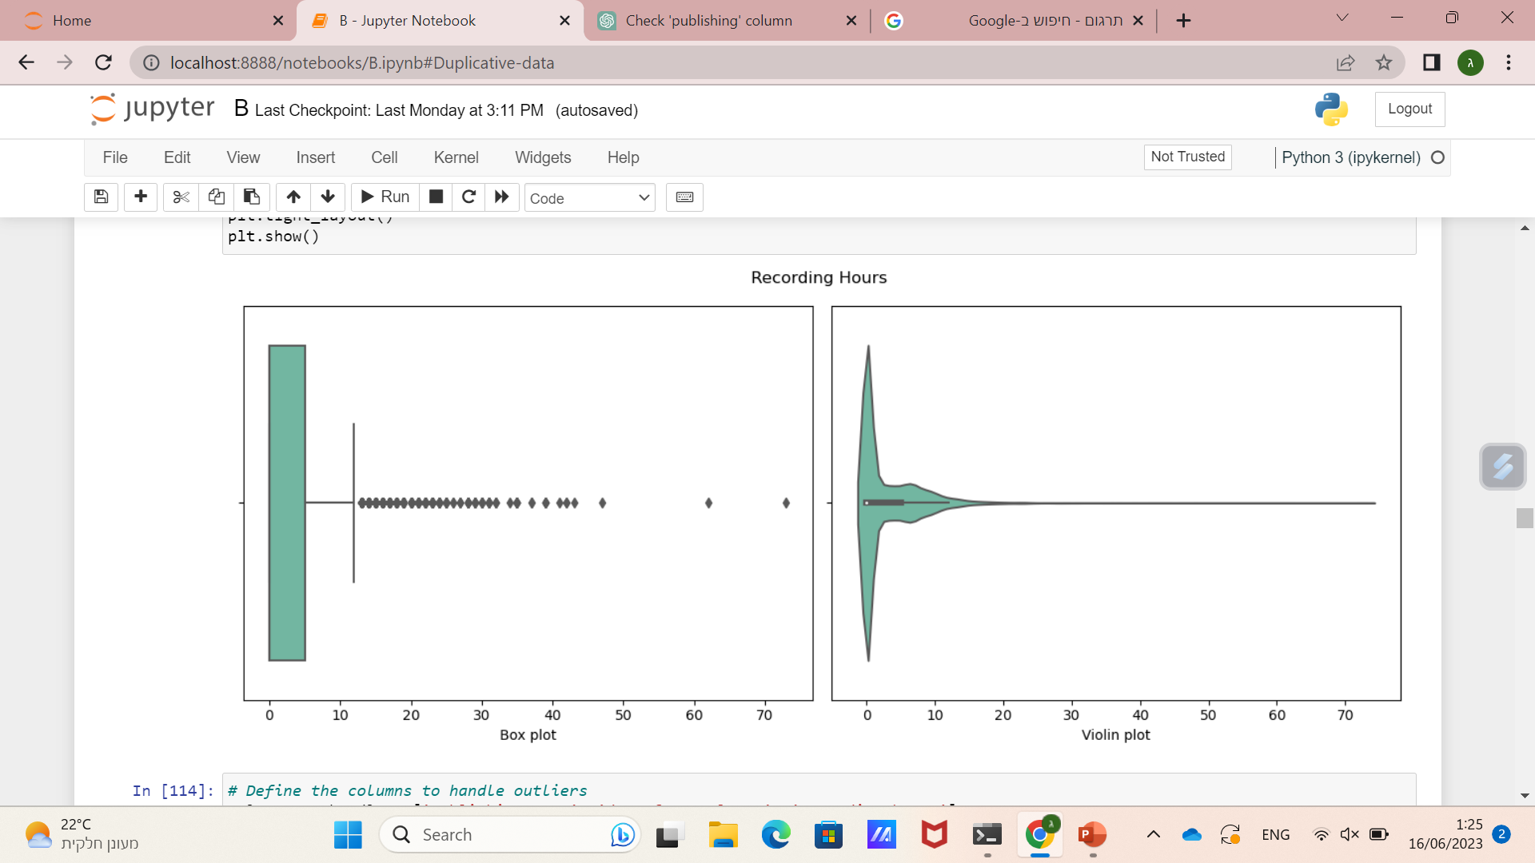
בס"ד

Slide 32
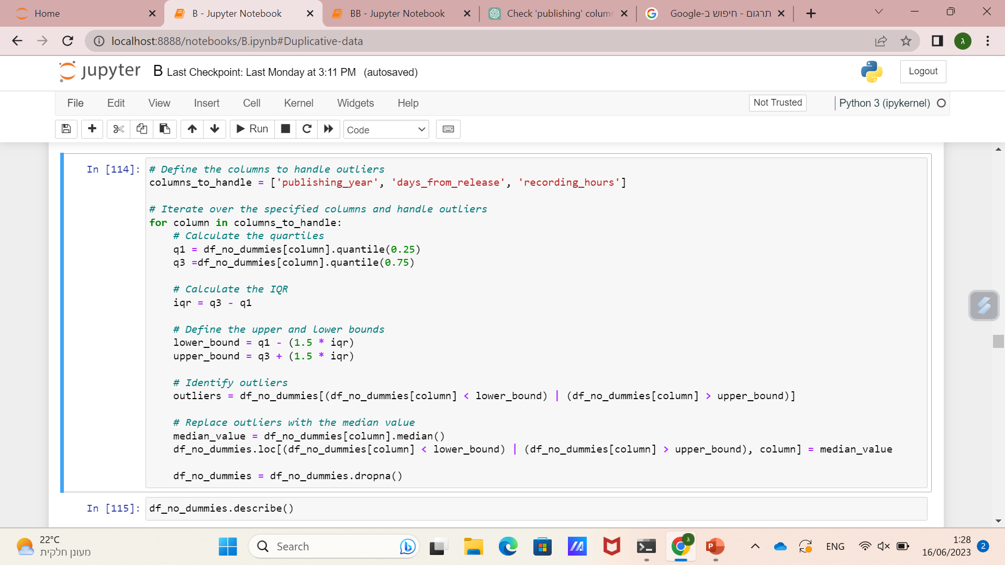
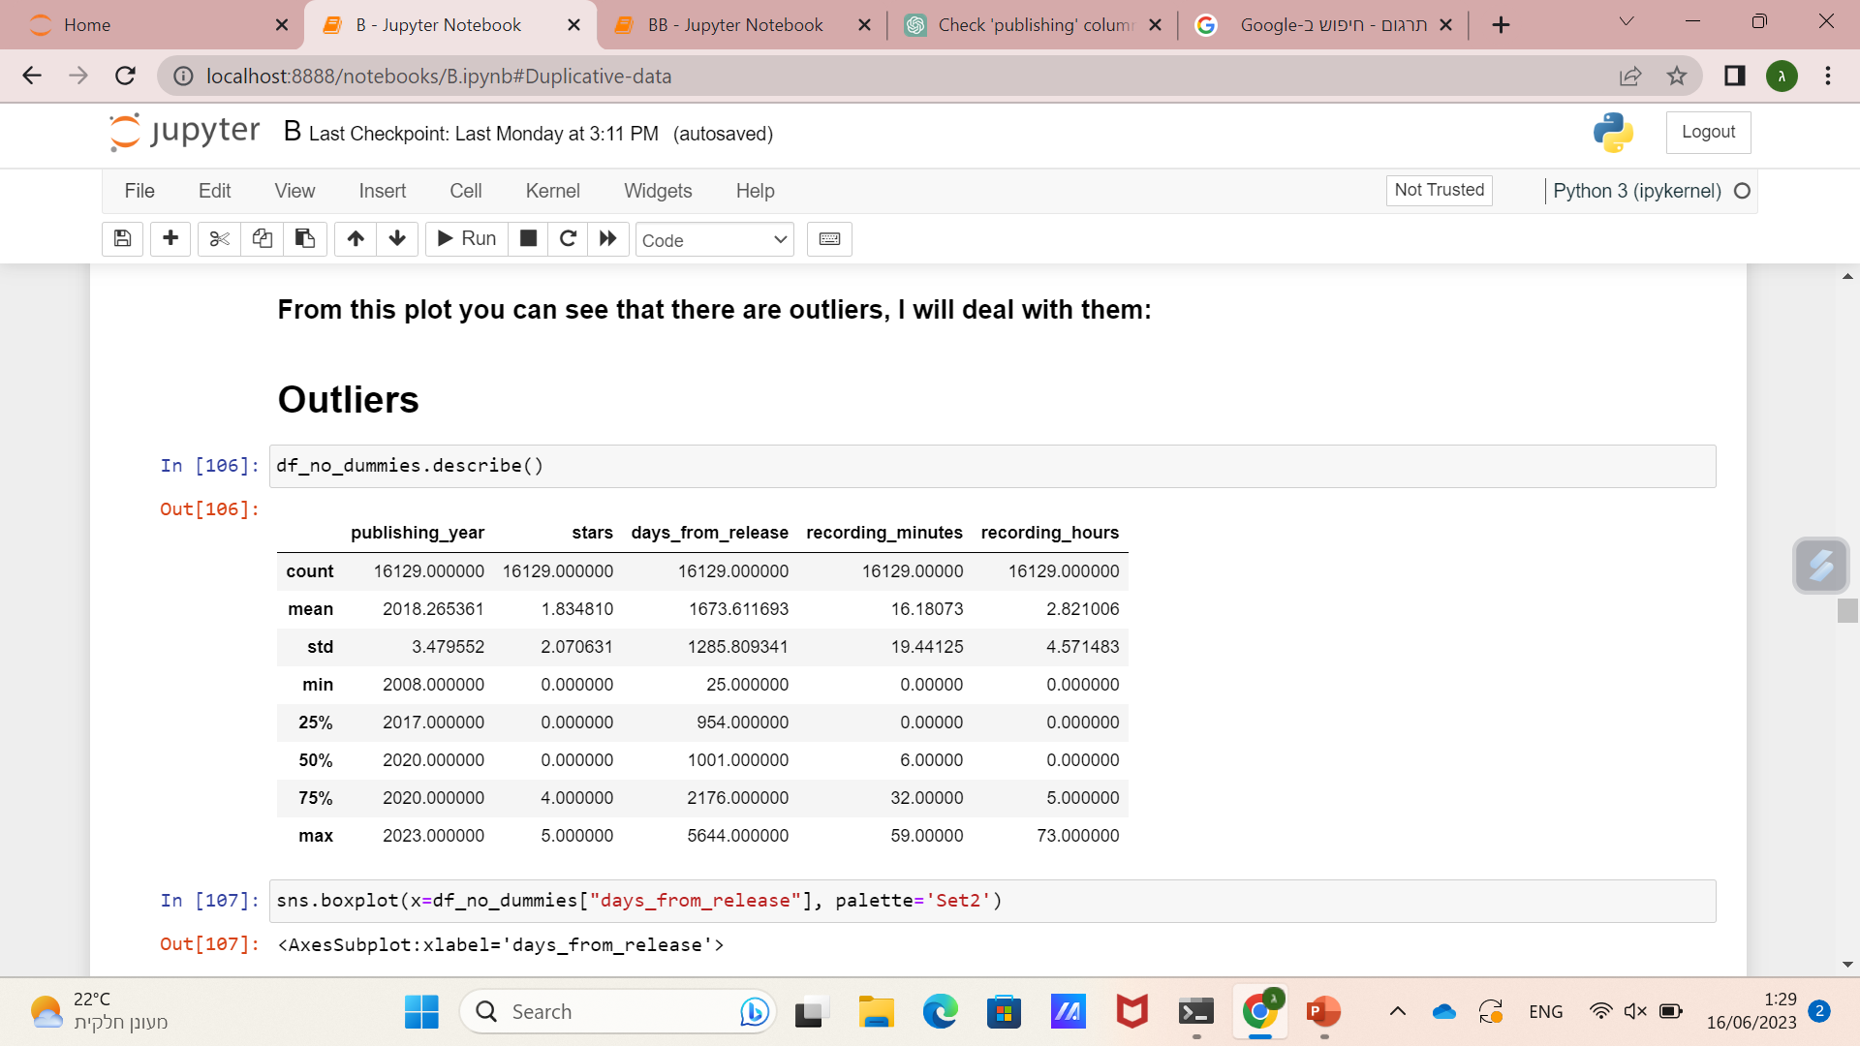
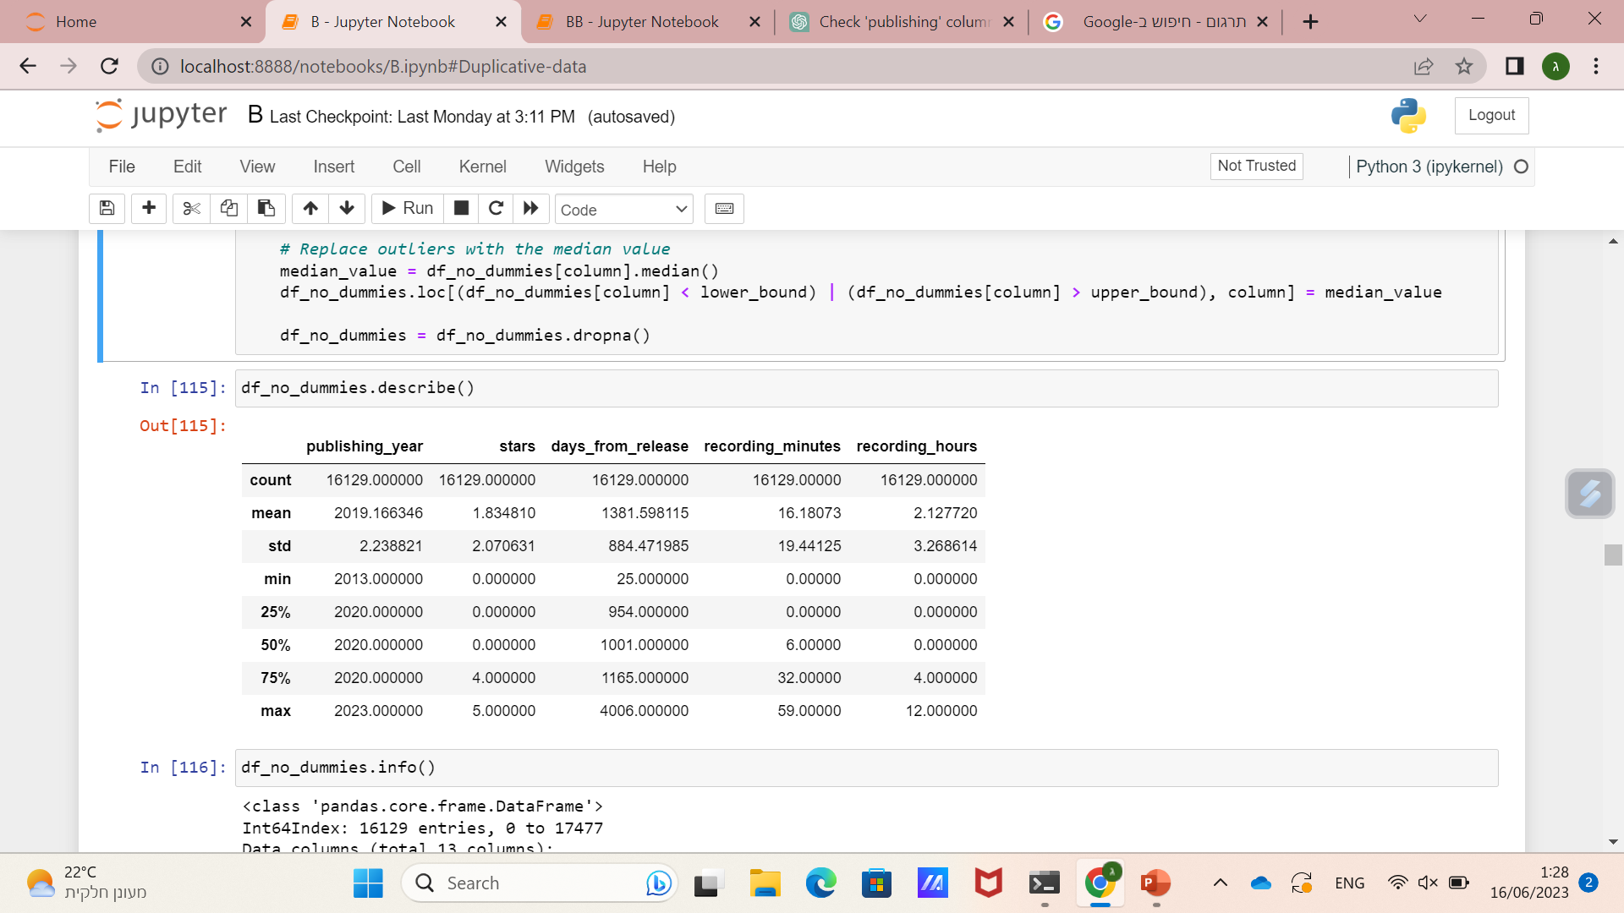
בס"ד
before
after

Slide 33
Machine learning
בס"ד

Slide 34
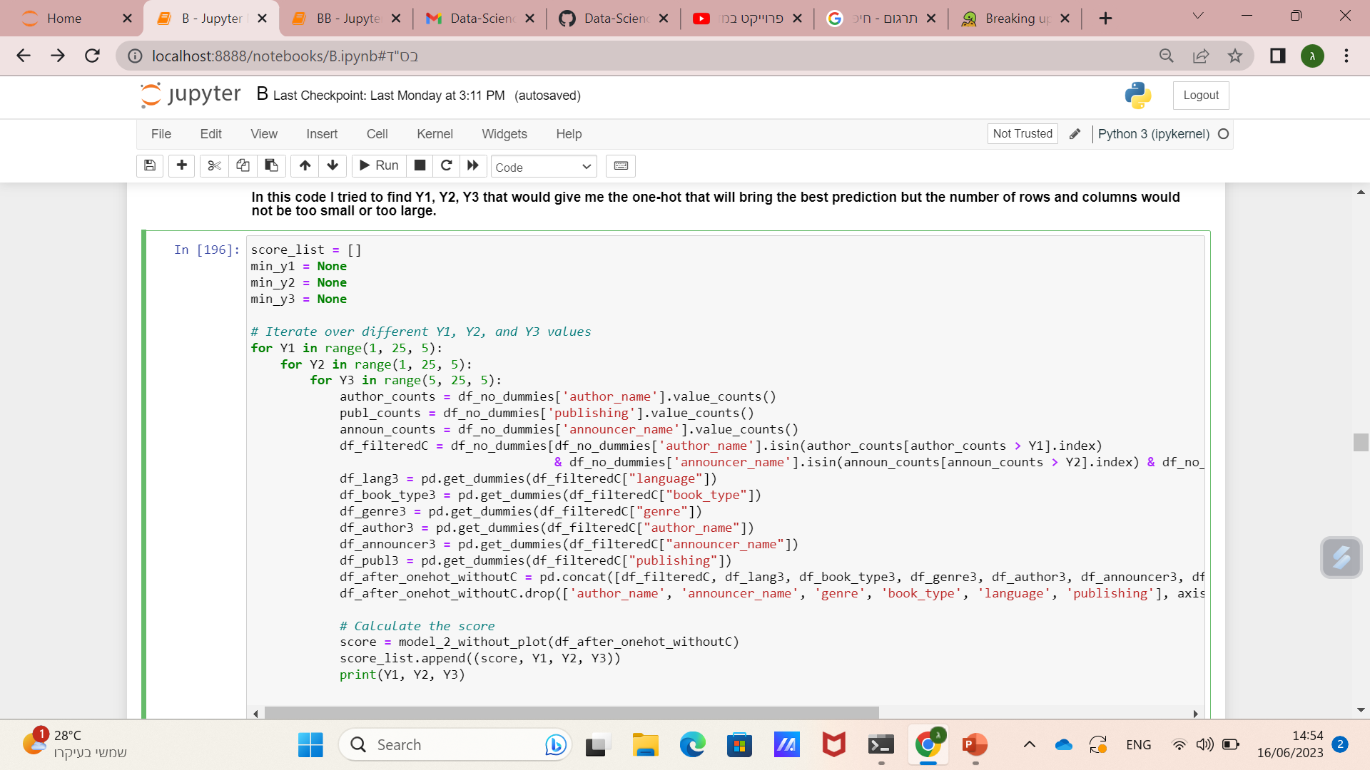
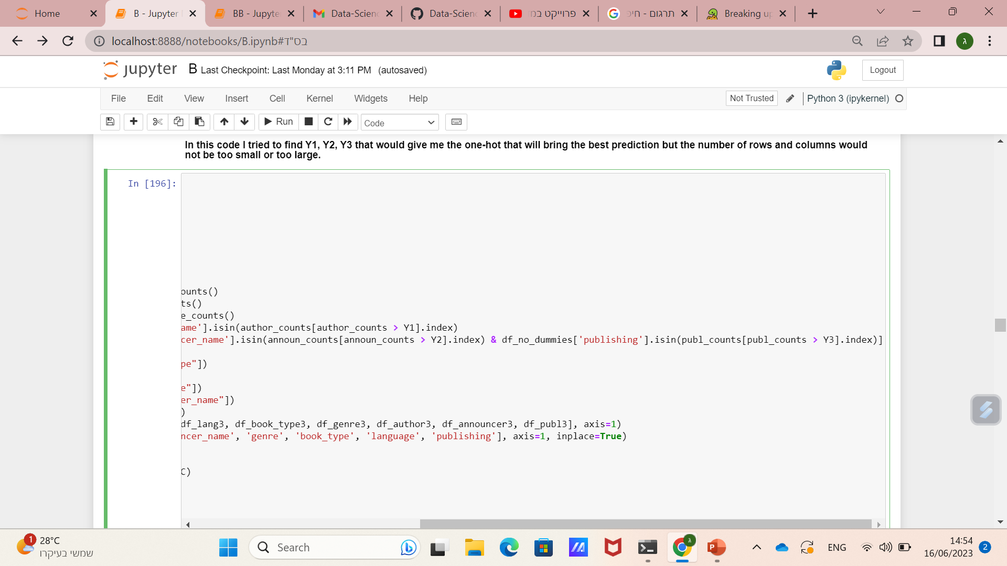
One-Hot
בס"ד

Slide 35
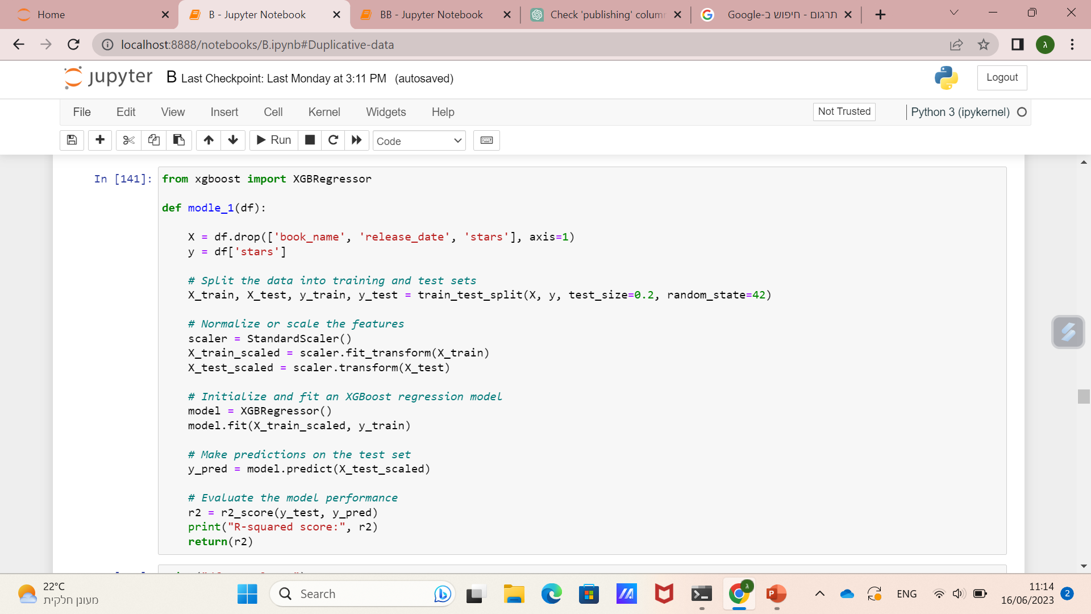

Regression
בס"ד

Slide 36



Classification
בס"ד

Slide 37

Results
בס"ד
Classification
Regression
Improvement
78.28%
+22.3%
101.4%
-0.369%
69.55%
You can see that the best accuracy is obtained from the DataFrame with 922 columns

Slide 38


df_26_columns
בס"ד

Slide 39


df_922_columns
בס"ד

Slide 40


df_1105_columns
בס"ד

Slide 41
Conclusion
בס"ד

Slide 42

בס"ד

